Slide 1
Scalable Multi-Period Optimal Power Flow for Active Power Distribution Systems or simply, Scalable MP-OPF in ADS
Aryan Ritwajeet Jha
Graduate Research Assistant
Washington State University
Notes:
Remember to hit the reset button to make sure all the page elements react properly.
There are 20 different layouts that you can choose from.

Slide 2
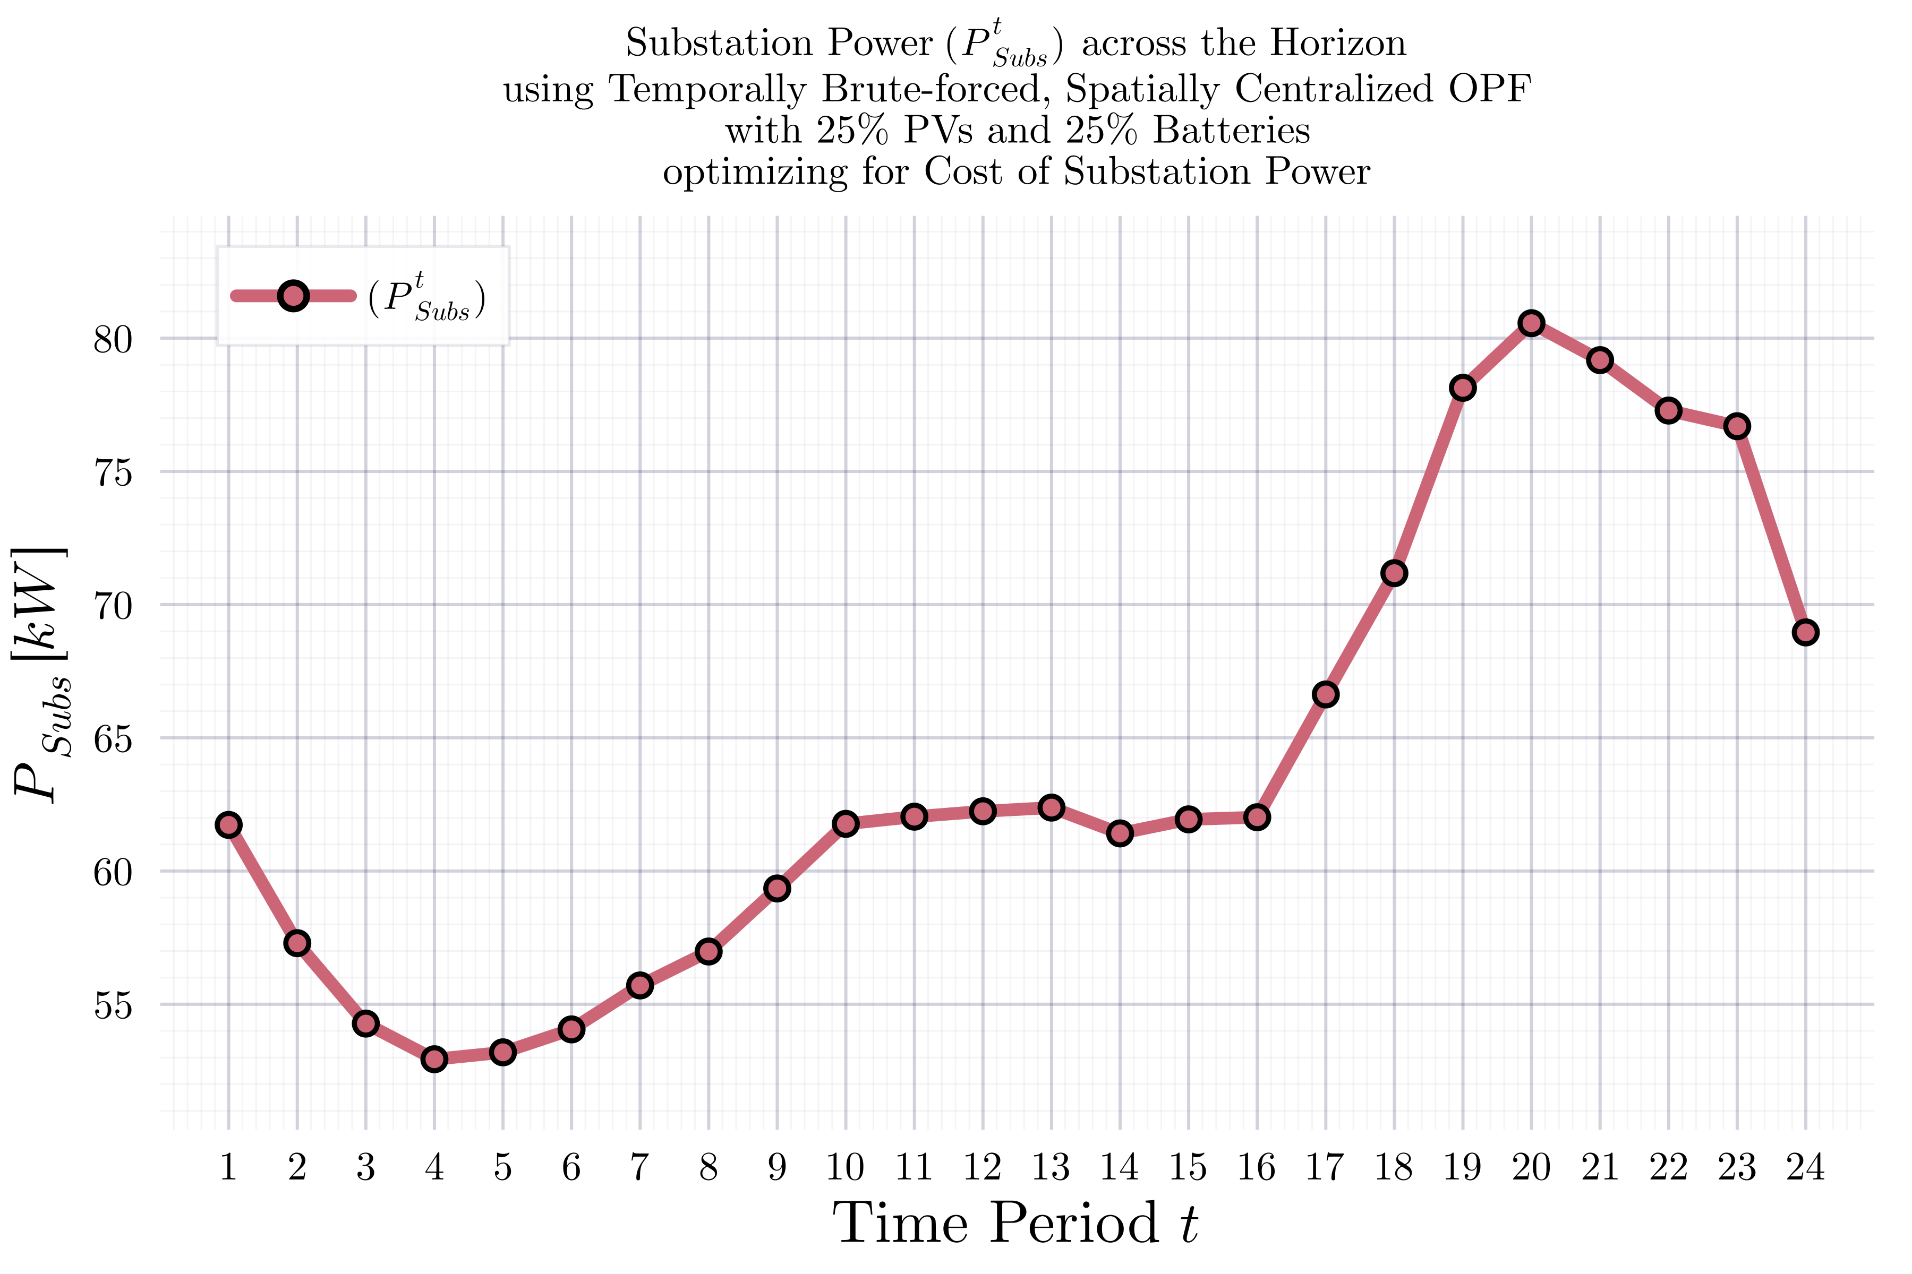
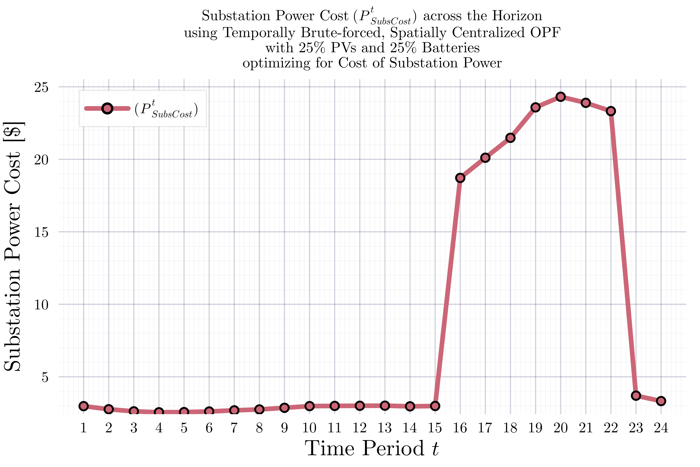
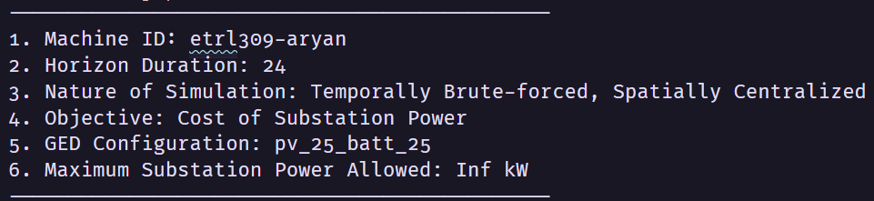
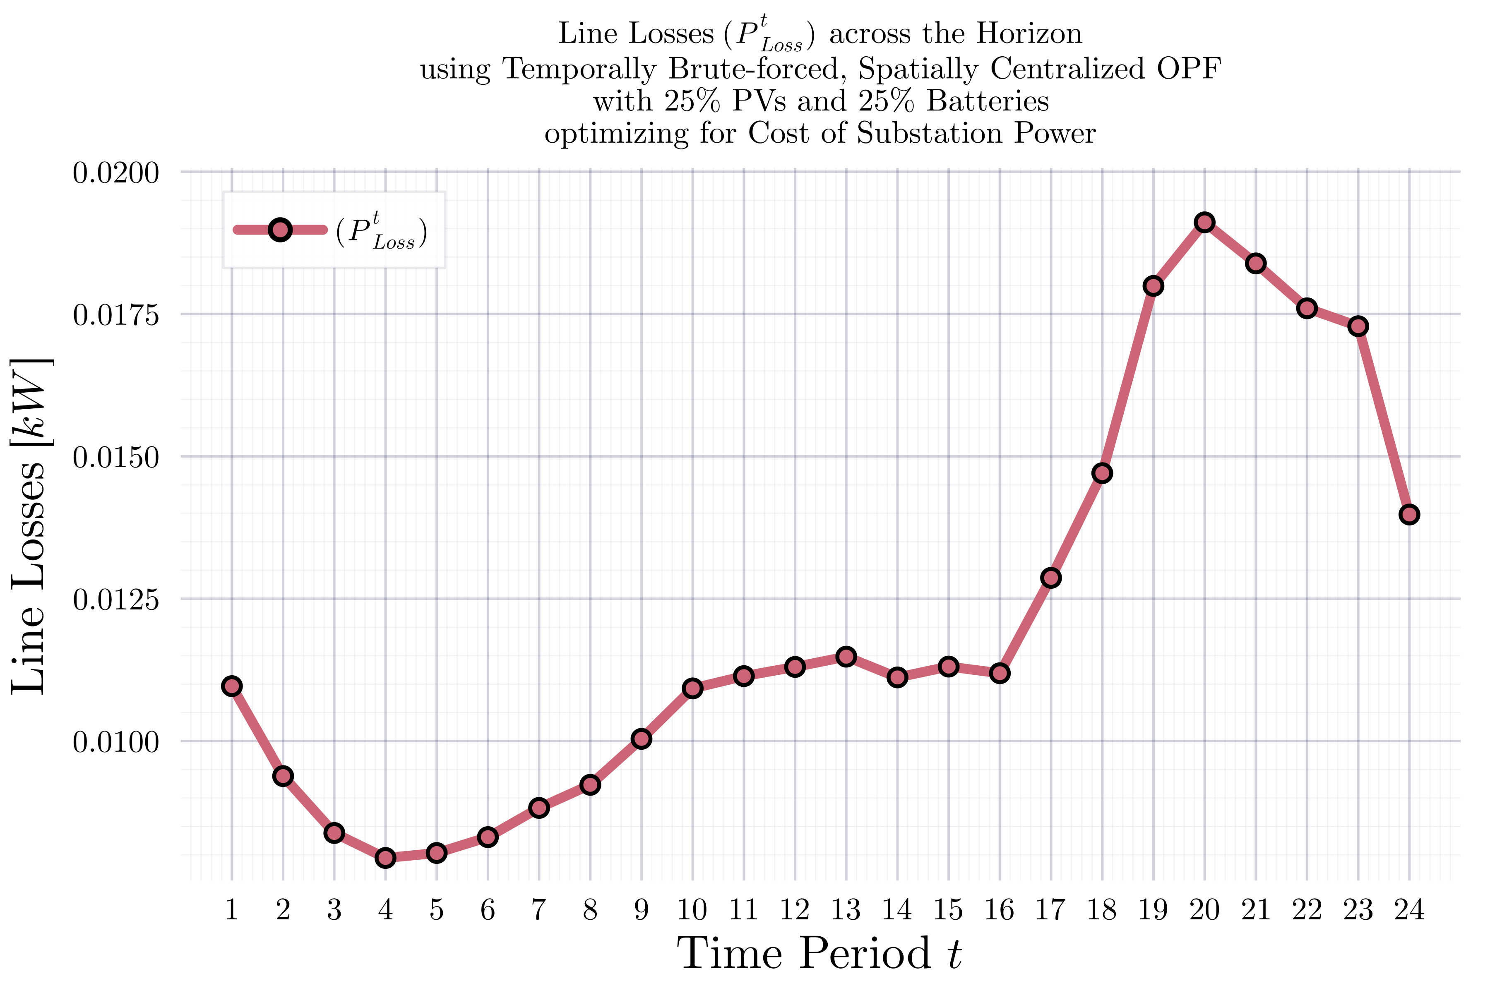
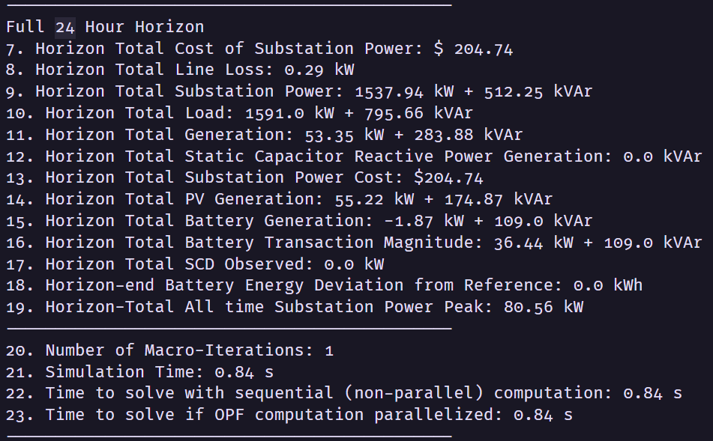
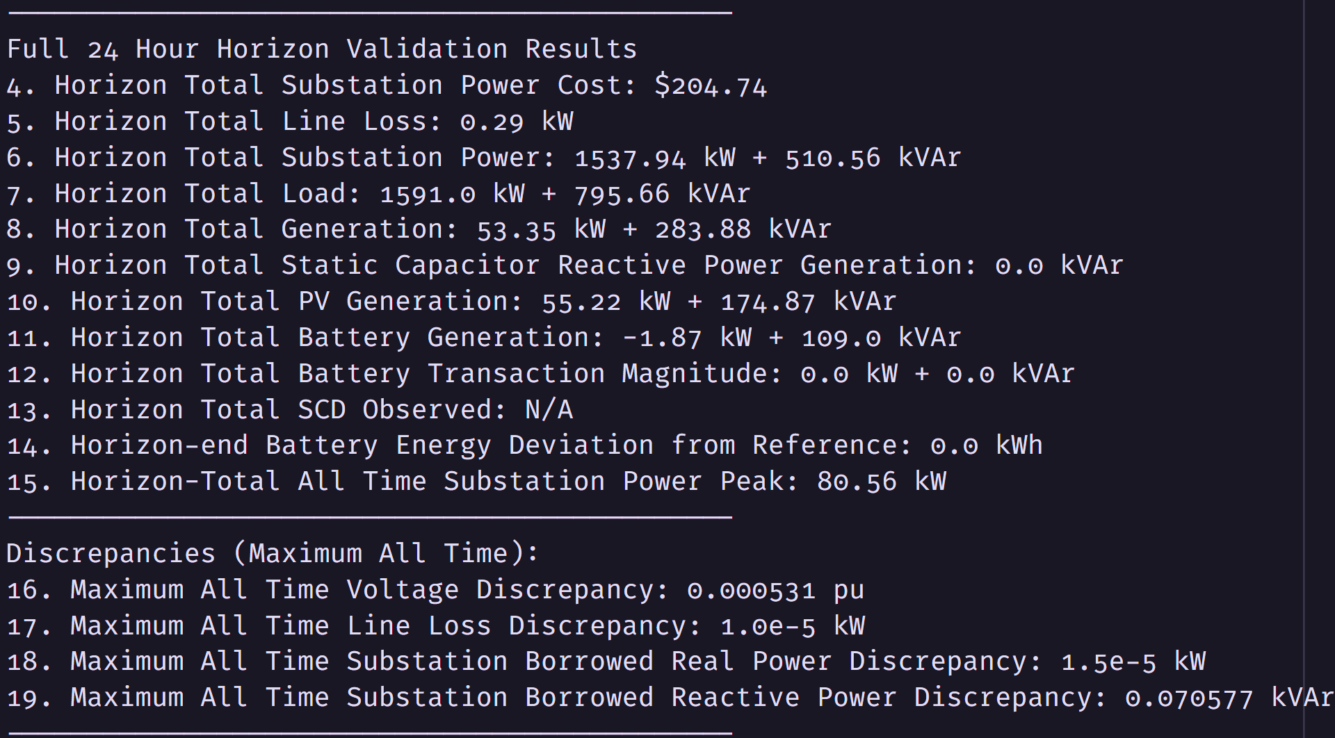

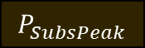
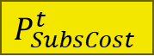

ADS$10$_$1$ph: MPCOPF Run for $T=24, PV=25\%, Batt=25\%$
OpenDSS Def Profiles
Substation Power Cost
$P_{Subs}^{t}$
$P_{SubsCost}^{t}$
$$P_{Loss}^{t}$$
MPCOPF Simulation Results
OpenDSS Powerflow Results
Objective
Objective
Miscomputation - will be fixed later
$$P_{SubsPeak}$$
Discrepancies
Timings

Slide 3
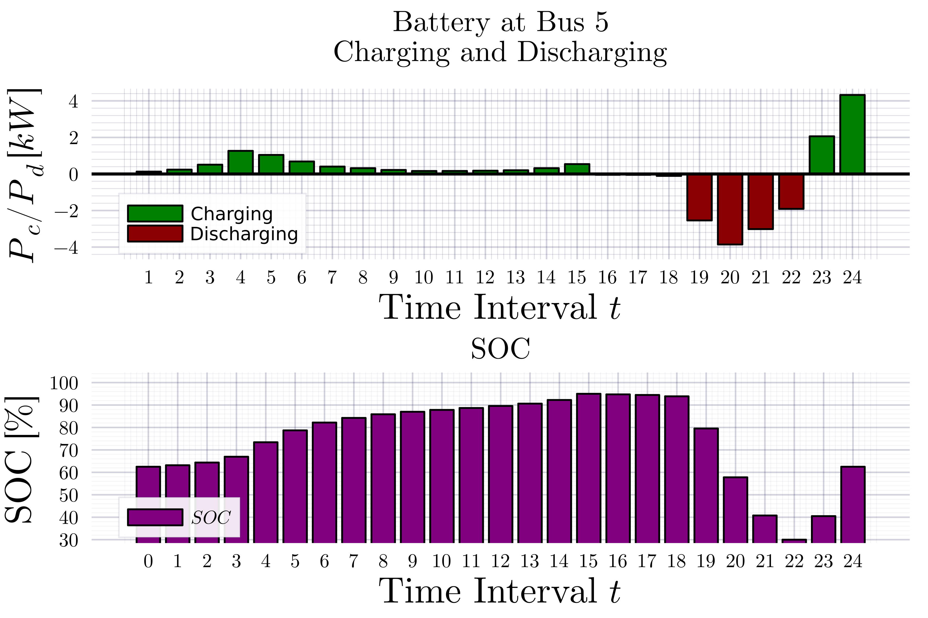
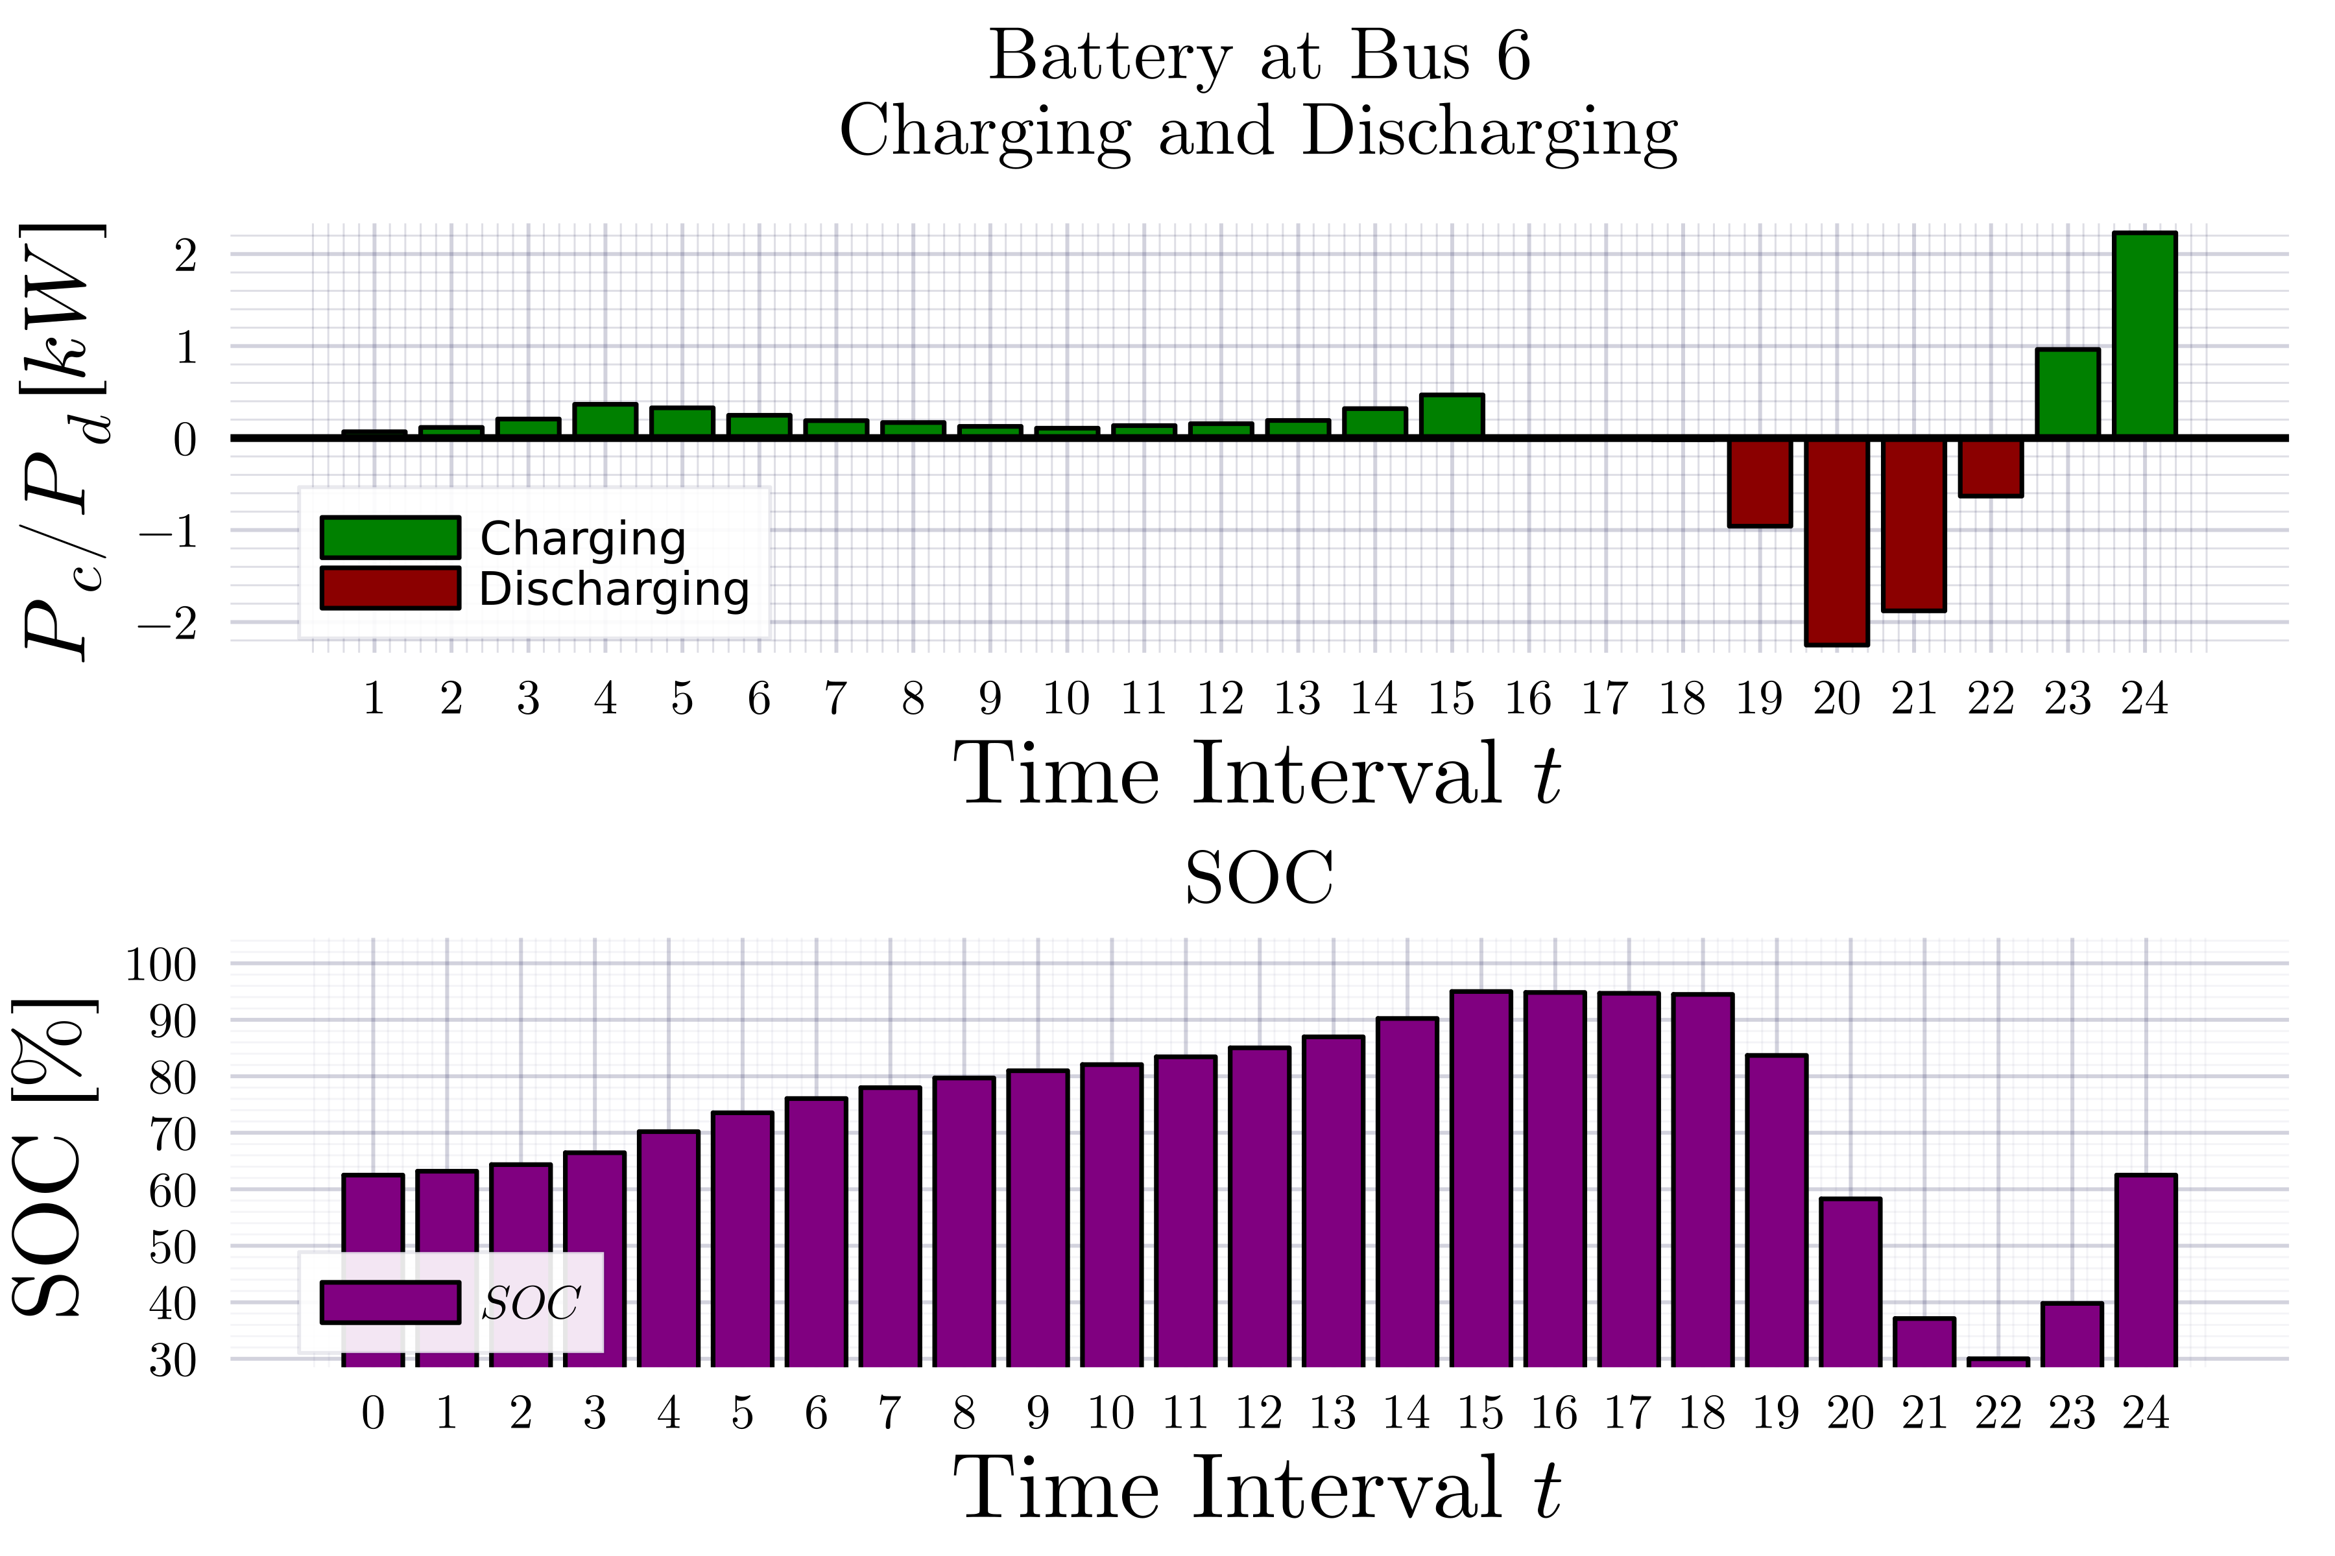
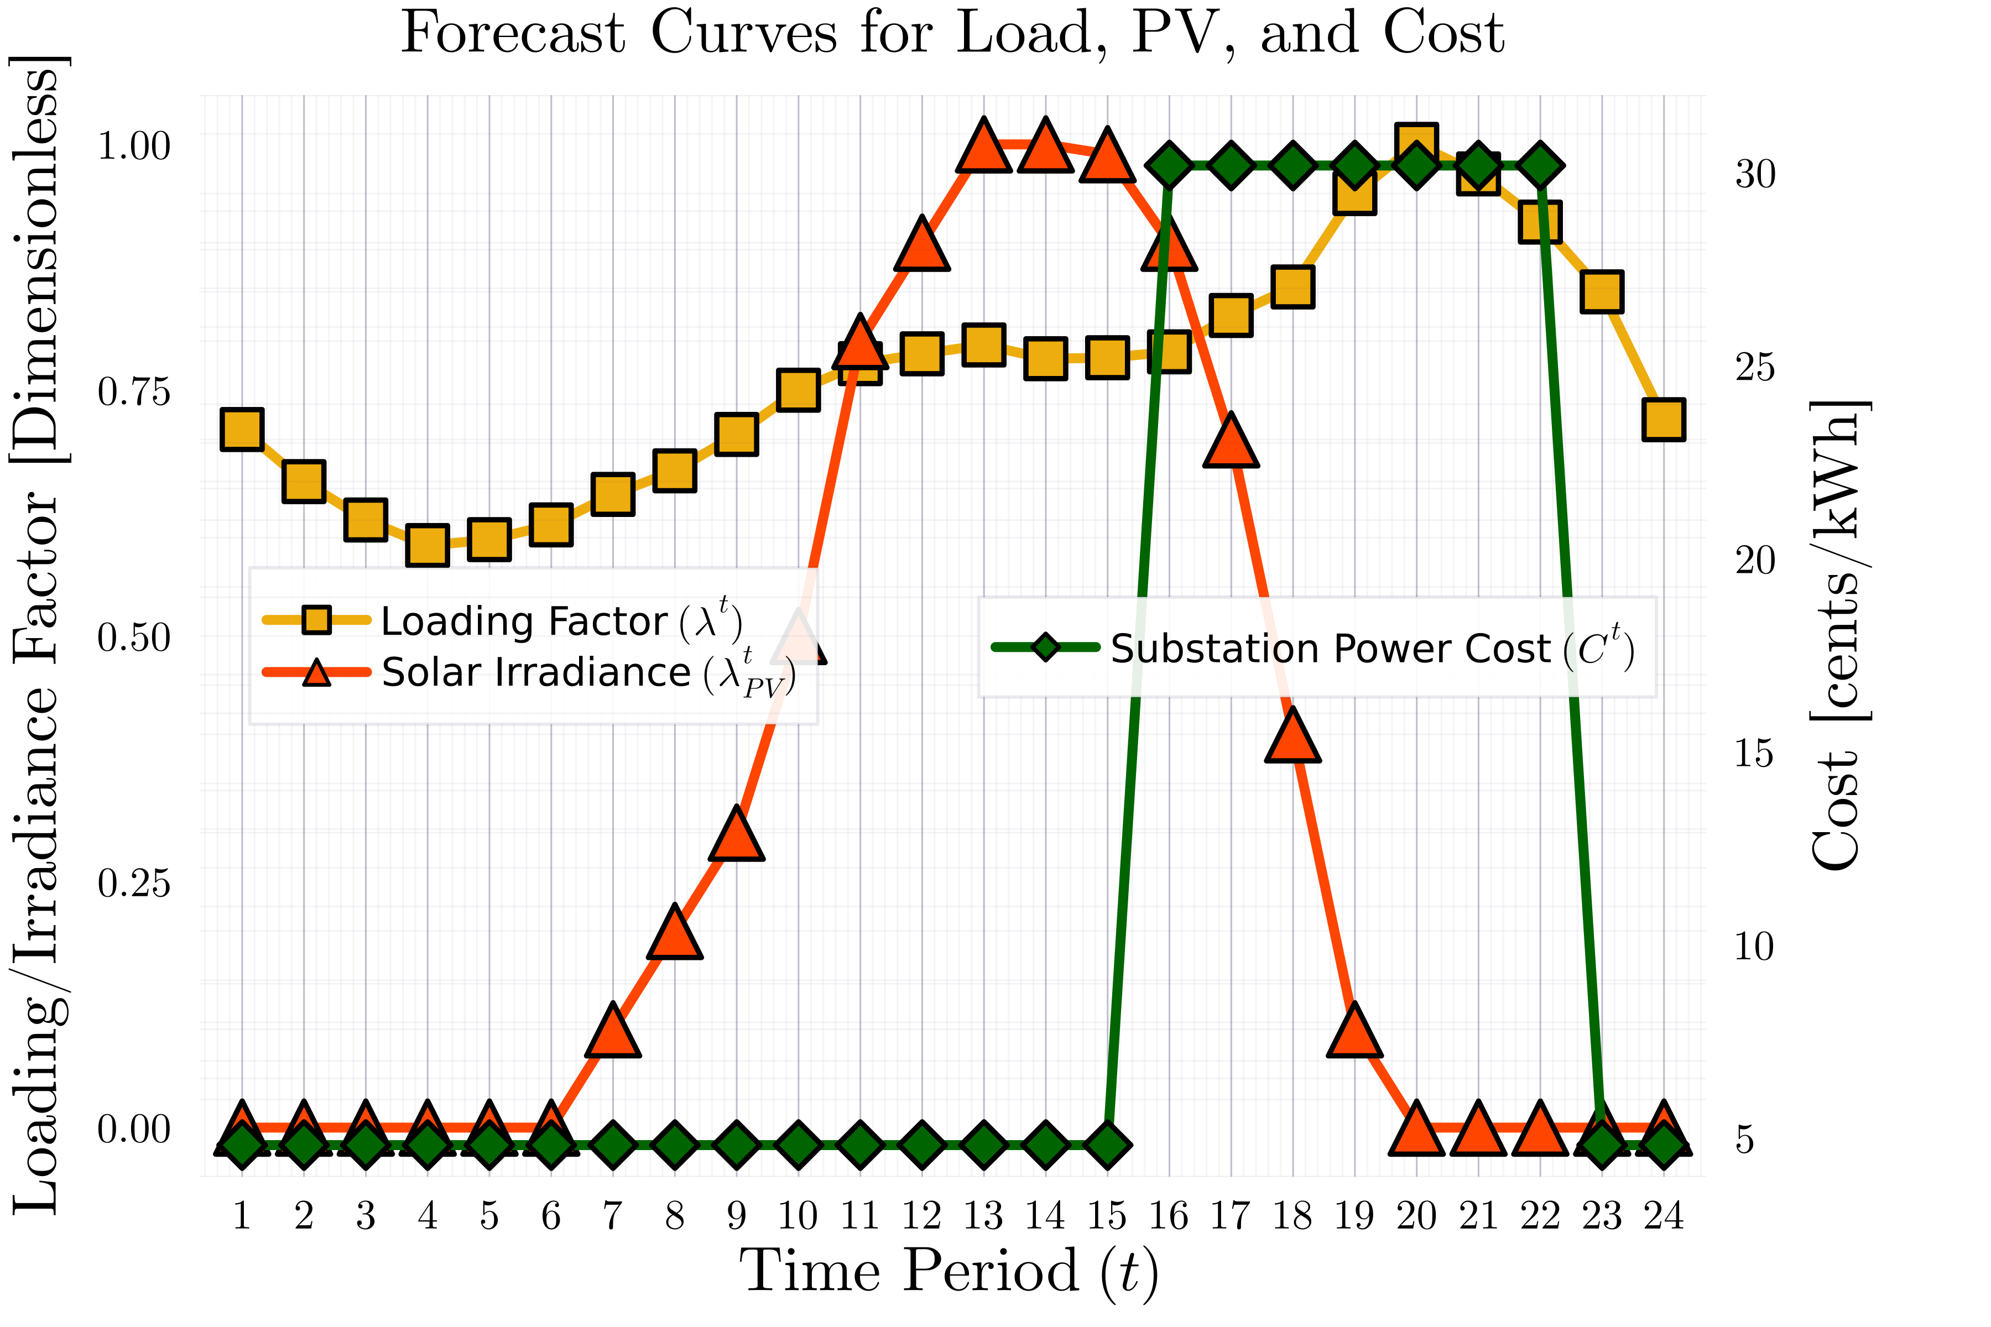
ADS$10$_$1$ph: MPCOPF Run for $T=24, PV=25\%, Batt=25\%$
OpenDSS Def Profiles
Substation Power Cost

Slide 4
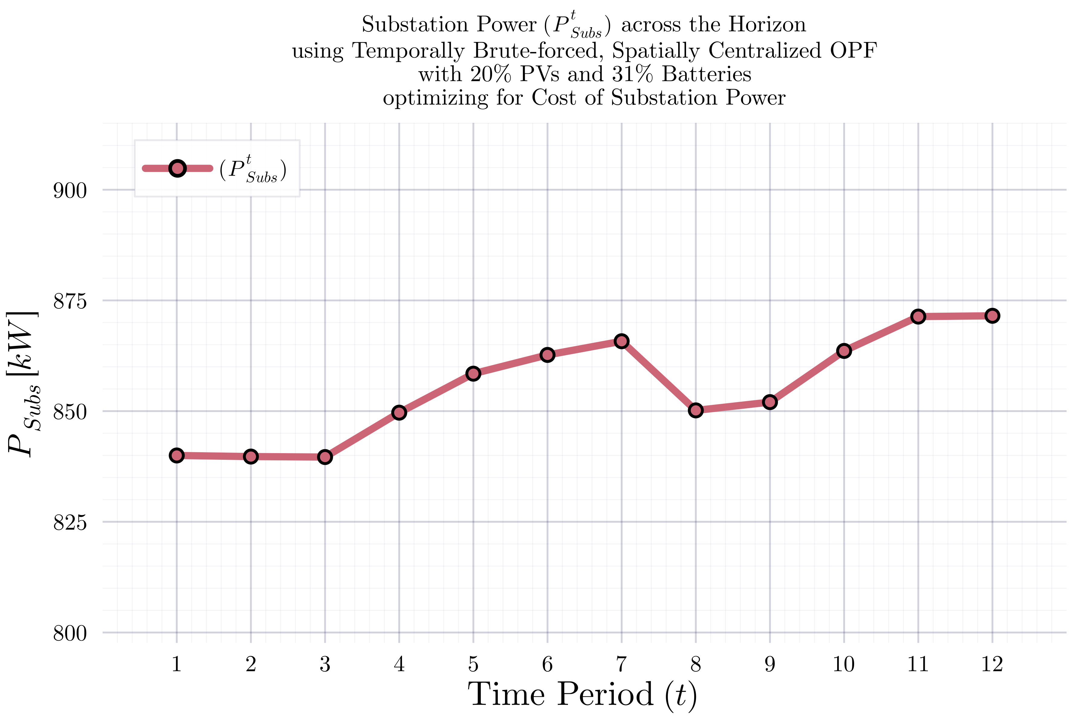
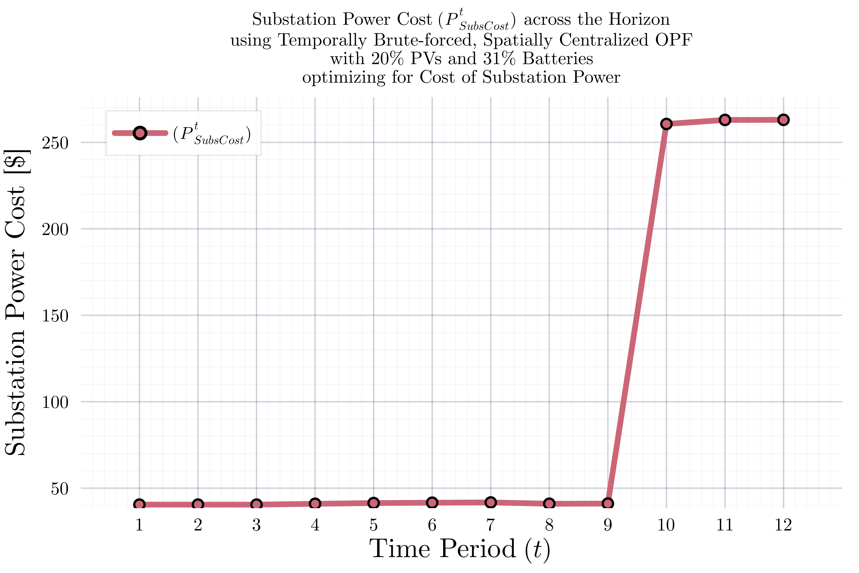
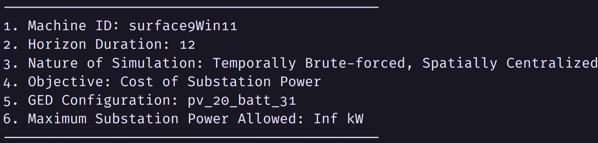
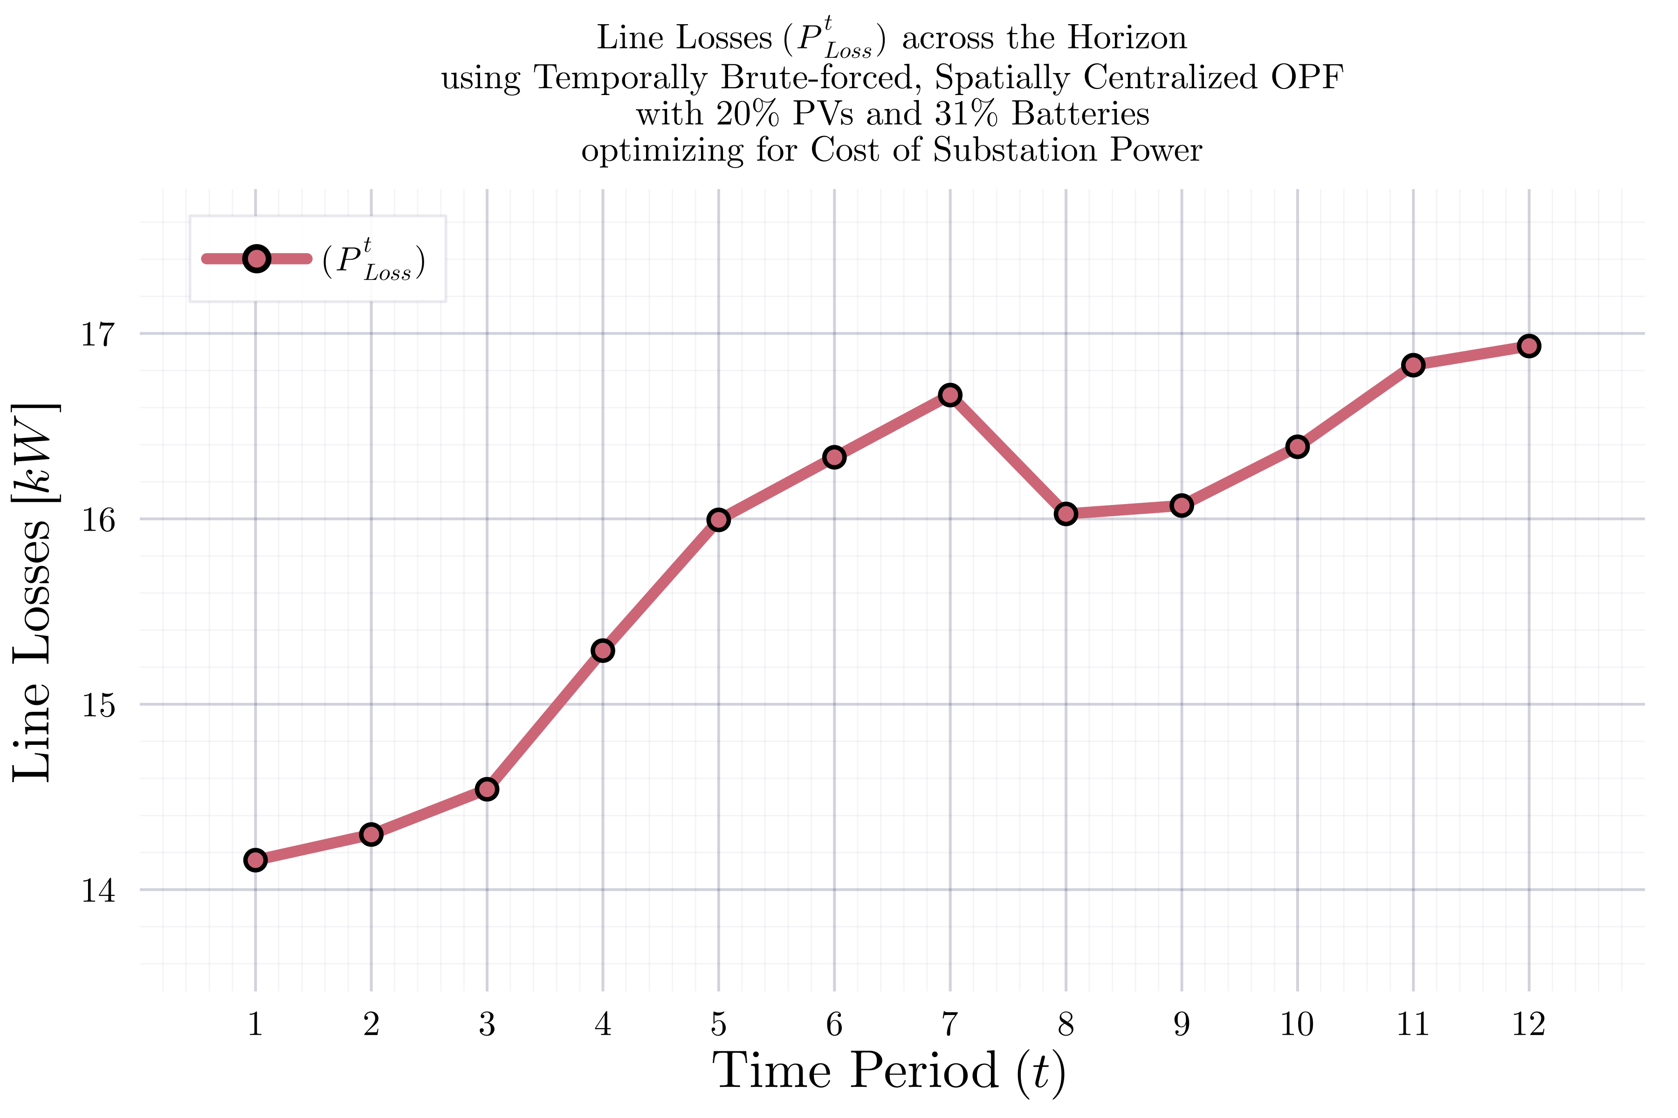
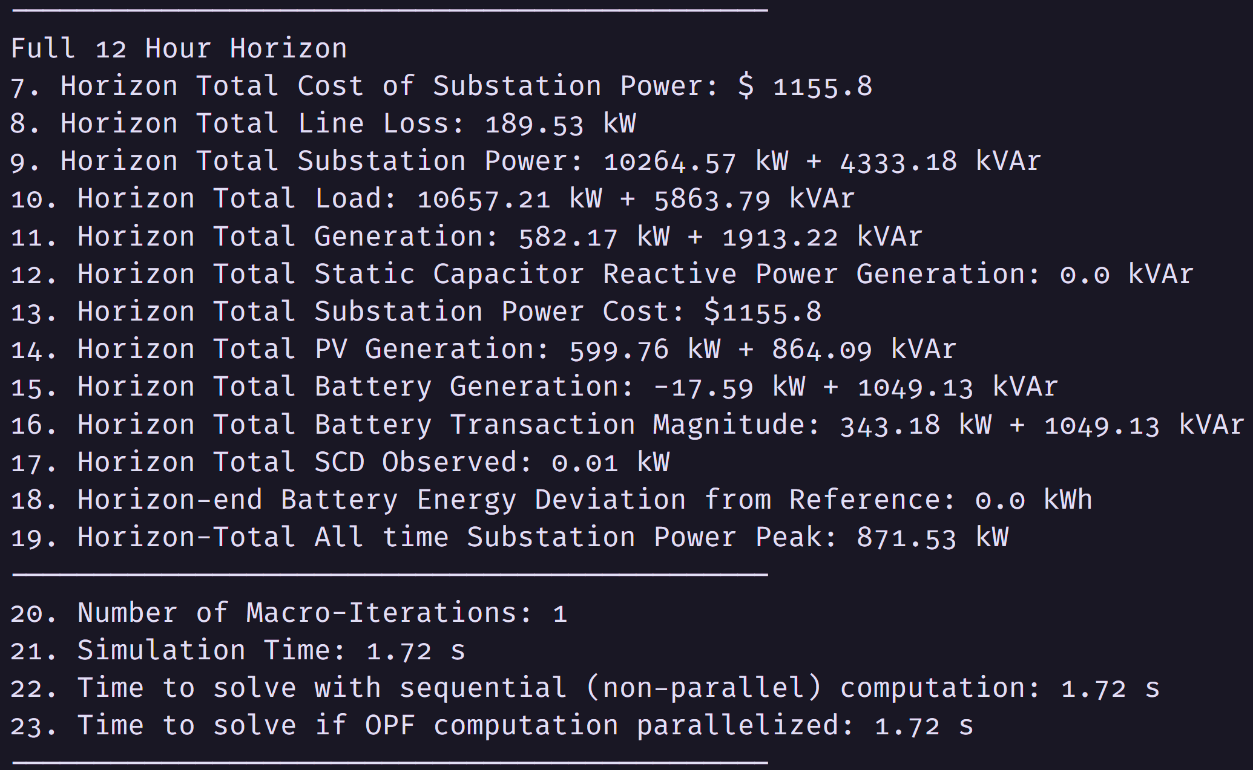
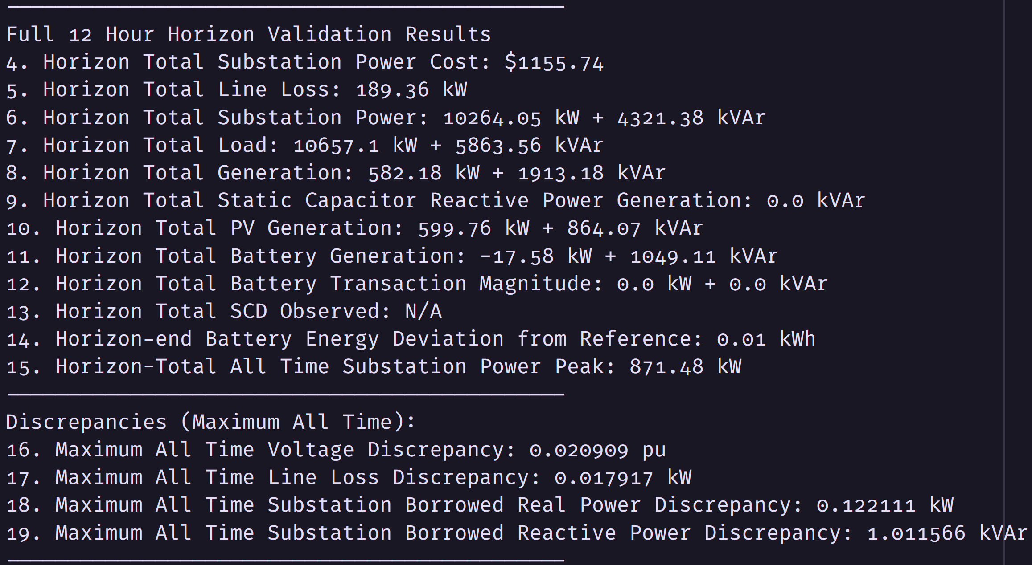
IEEE$123$_$1$ph: MPCOPF Run for $T=12, PV=20\%, Batt=30\%$
OpenDSS Def Profiles
Substation Power Cost
$P_{Subs}^{t}$
$P_{SubsCost}^{t}$
$$P_{Loss}^{t}$$
MPCOPF Simulation Results
OpenDSS Powerflow Results
Objective
Objective
Miscomputation - will be fixed later
$$P_{SubsPeak}$$
Weirdly high discrepancy in voltage (will be investigated)
Discrepancies
Timings

Slide 5
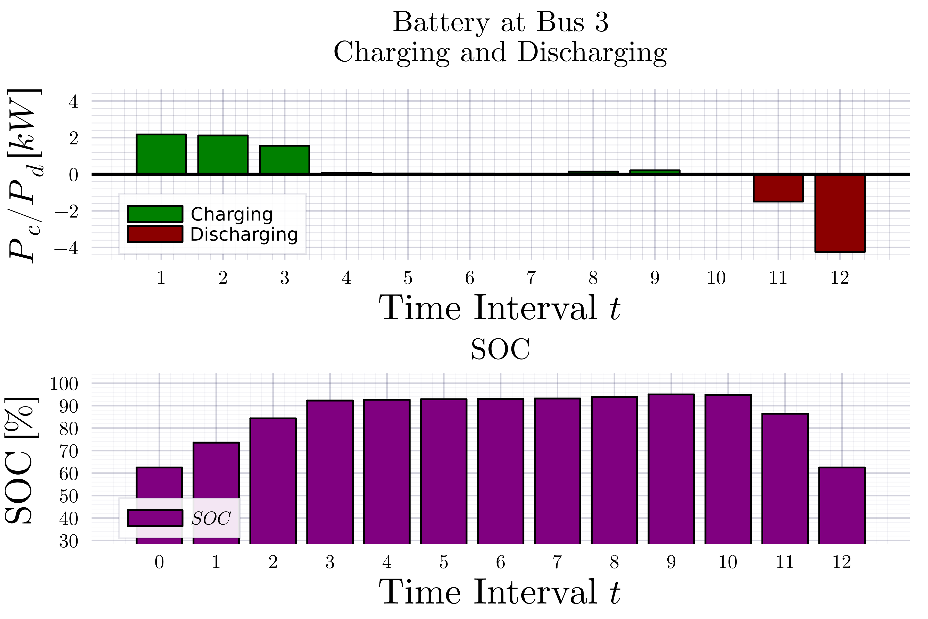
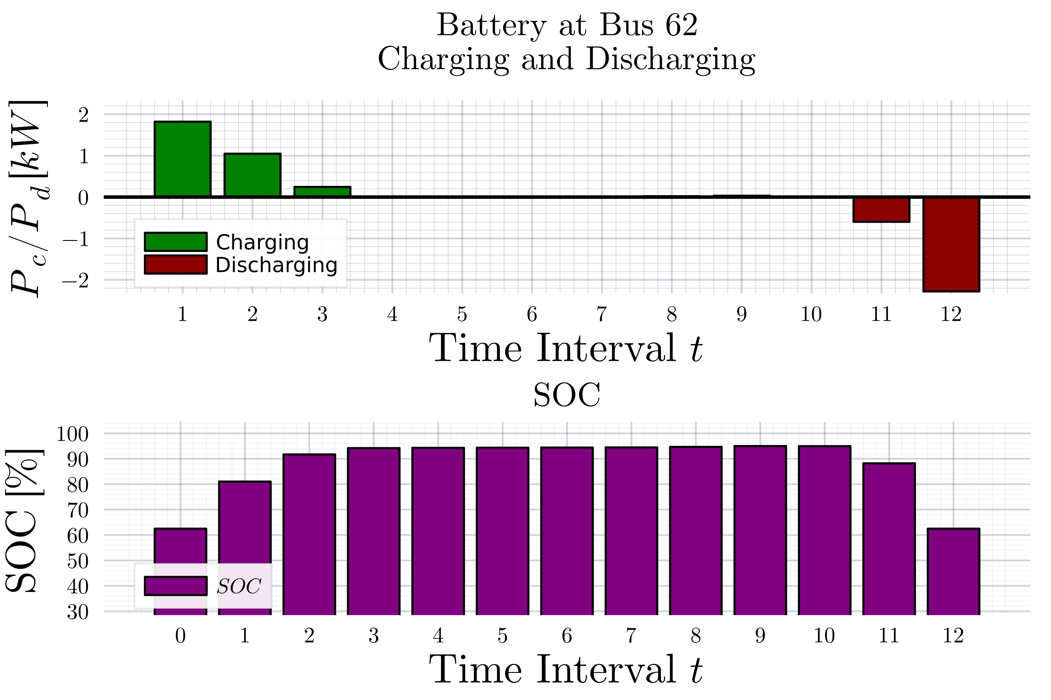
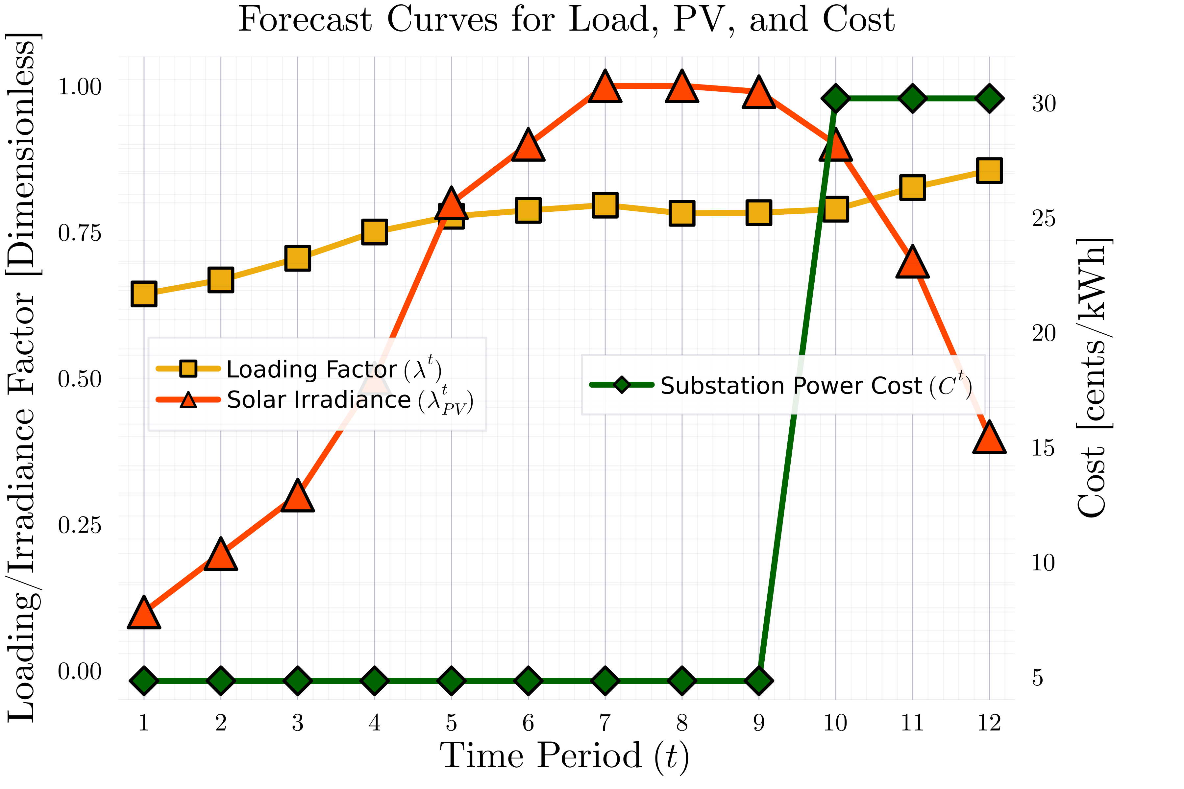
IEEE$123$_$1$ph: MPCOPF Run for $T=12, PV=20\%, Batt=30\%$
OpenDSS Def Profiles
Substation Power Cost

Slide 6
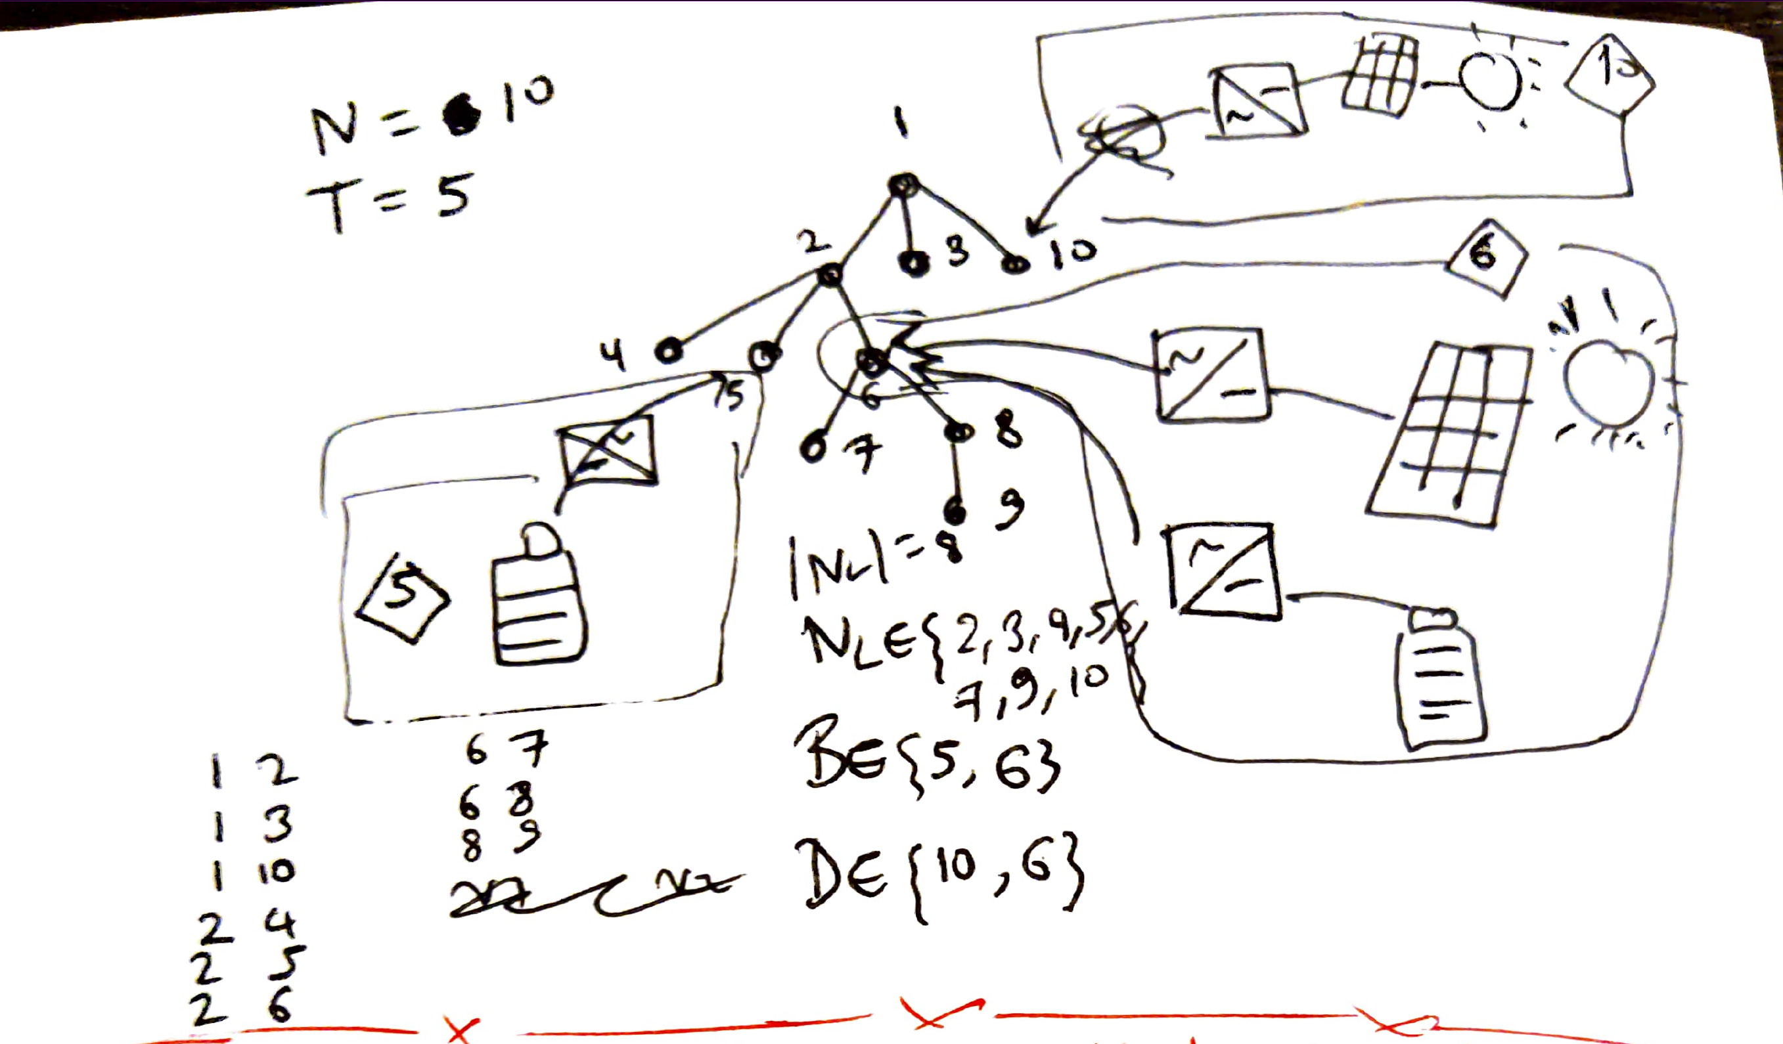

Three Steps for Optimization Implementation (and what will be different for DDP):
[No change] Loading Simulation Configuration from OpenDSS (.dss) files, Pre-optimization housekeeping
[Some change] Optimization Routine (Temporally brute forced optimization now verified, can be used as ‘Benchmark’ result for checking Optimality Gap)
[No change] Post Optimization result validation via OpenDSSDirect
Now onto writing the script for DDP optimization routine ..
Initial Test System: ADS$10$_$1$ph with $8$ Loads, $2$ PVs and $2$ Batteries

Slide 7

Latest Slides End Here. Previous Slides Follow.

Slide 8
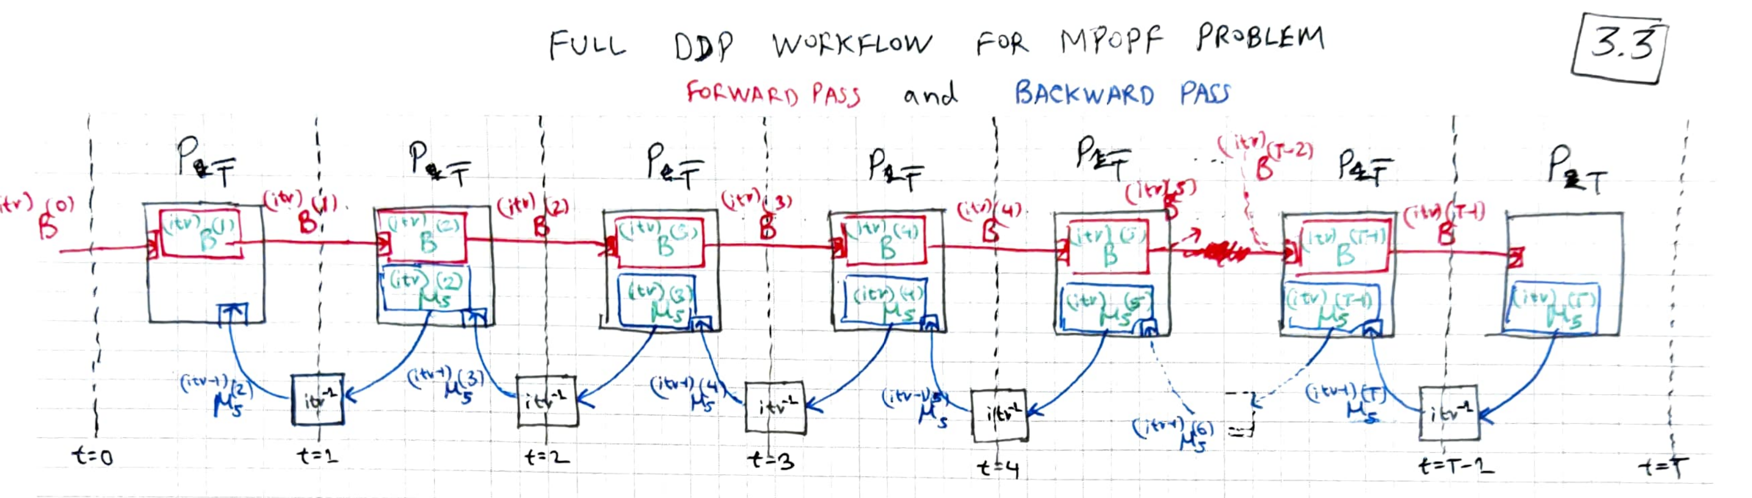
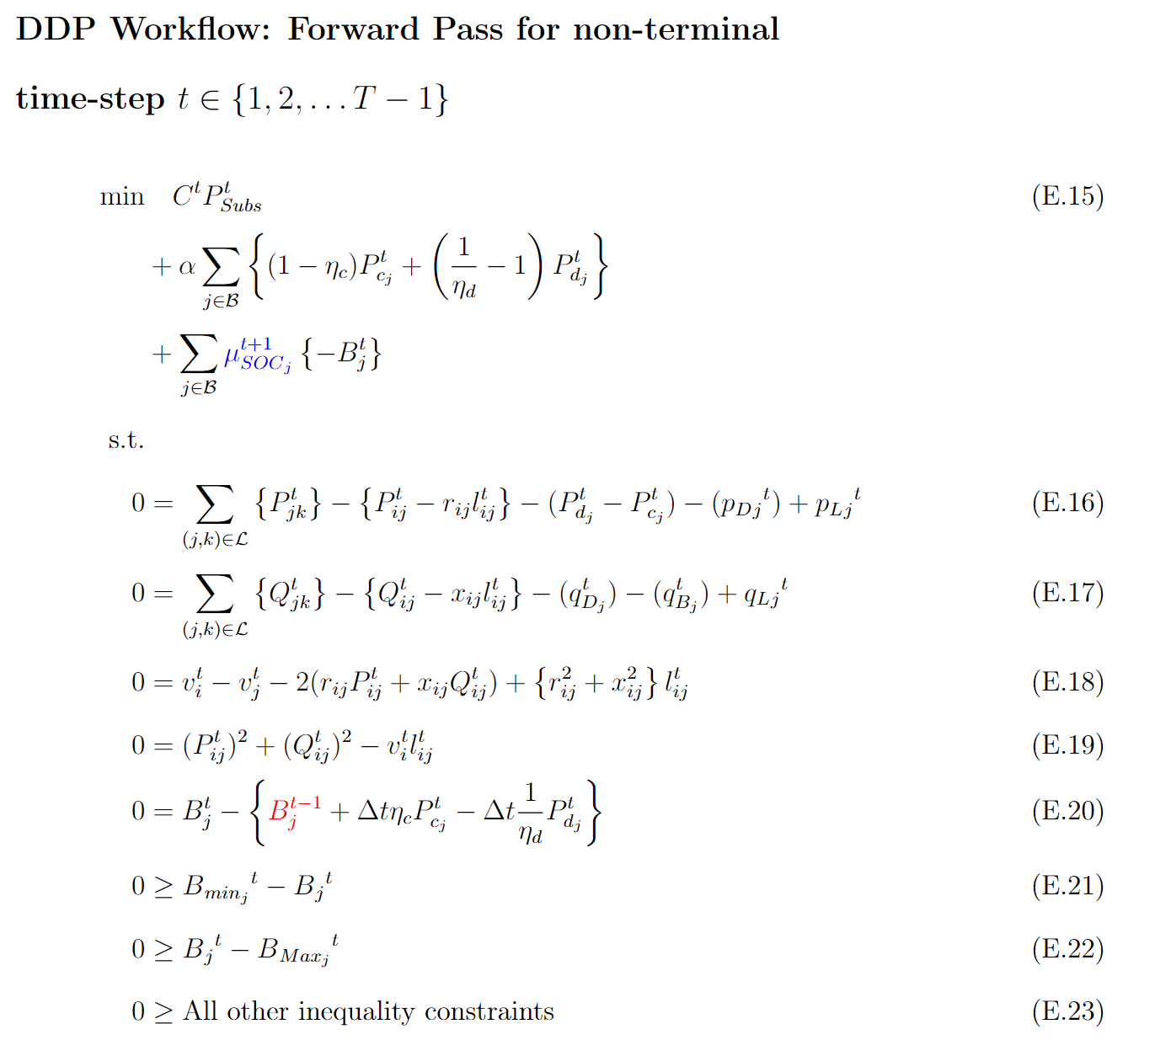
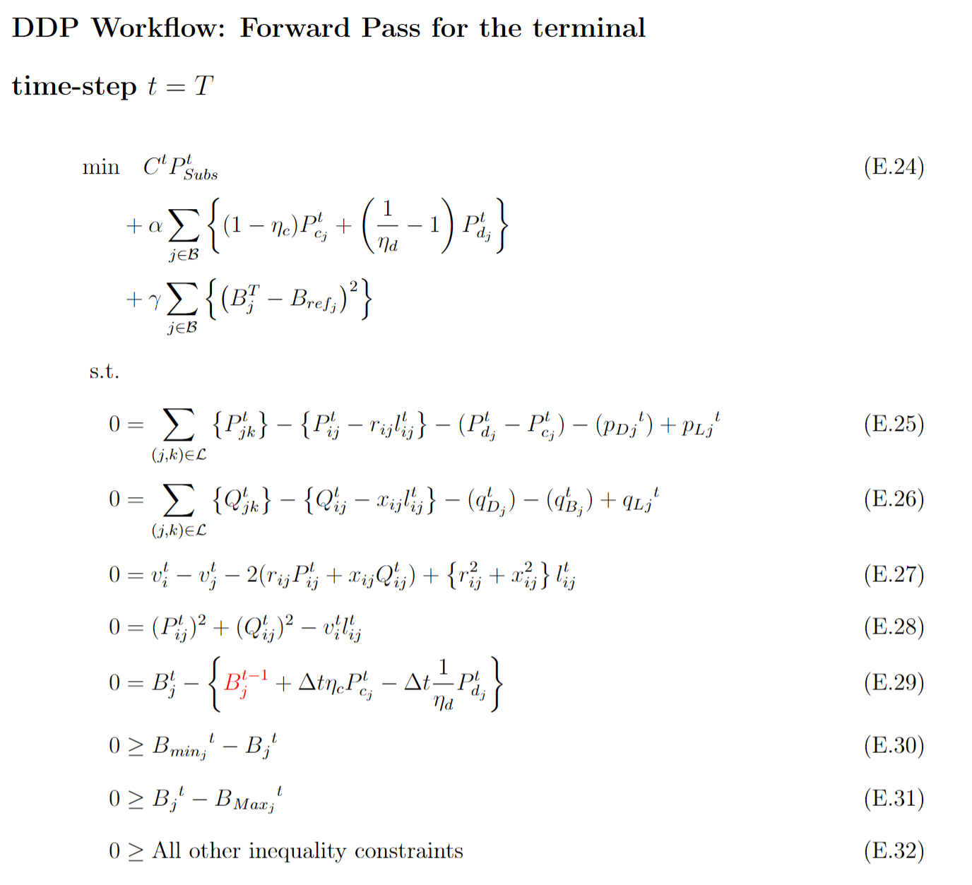
DDP for MPOPF for ADS Workflow

Slide 9
DDP for MPOPF for ADS Workflow

Slide 10
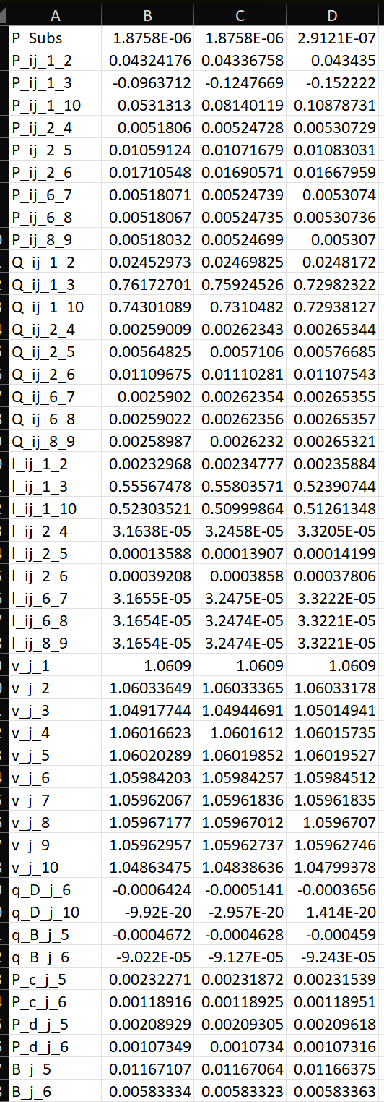
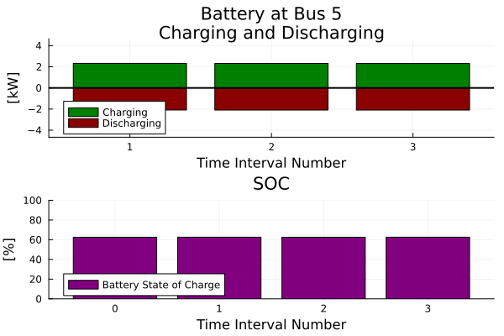
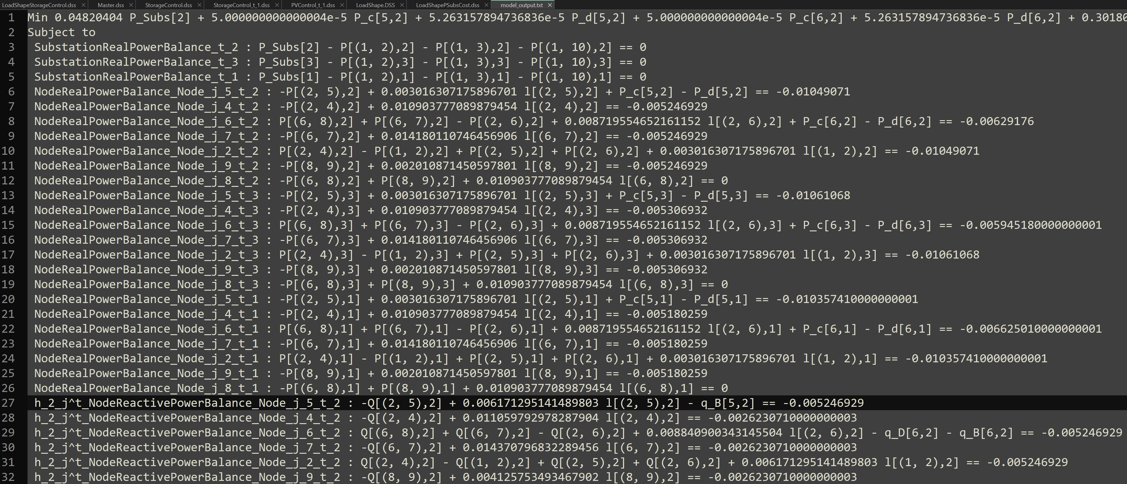
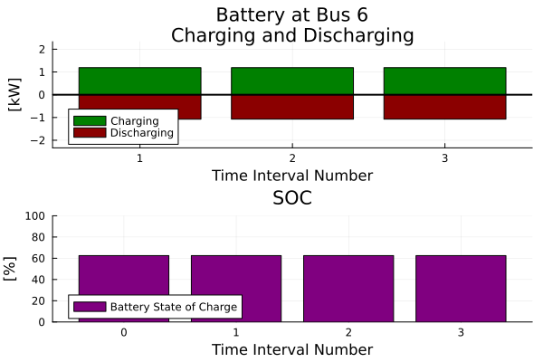
New MPOPF Implementation Progress
Currently converging .. to a non-sensible solution (zero substation power)
Hmm no reason for no GED load node 3 to have power backflow
Of course, SCD is also there.
Current thoughts: Bad sign in constraints? Bad per-unit-ization of a parameter?
Also checking out the constraints used

Slide 11
Steps towards understanding Temporal Decomposition – Which Papers to Read?
Find work where it has actually been used.
Beginning with only those which solve for the MPOPF problem.
Right now, Transmission systems are OK too (they have to deal with ramping up/down constraints for generators)
But may look into other domains as well afterwards
Ascertaining which approach to follow, based on certain desirable features the future algorithm should have.

Slide 12

Steps towards understanding Temporal Decomposition – Intended Algorithmic Solution
Desirable features the future algorithm should have:
Should be scalable with respect to Time (horizon duration)
At least, something like $96$ time-steps should be solvable in one go
Should ideally solve for the ‘true’ nonlinear problem, with as few approximations as possible
Relaxations however are fine, and if they’re used, their solutions will obviously be checked for any infeasibility.
Changing optimization formulation is undesirable for me. Something close to, if not exactly the same as the ‘standard’ nonlinear Branch Flow Model [farivar2013] is what I want.
So, I’m looking to solve the problem using Branch Flow Variables $P_{ij}, Q_{ij}, v_{j}, l_{ij}$ only.
Many papers, bring out their own new set of variables, approximations, customized algorithms to deal with them, in order to solve for the MPOPF problem. This is NOT what I’m looking to do.

Slide 13
Do others ‘scalably’ solve MPOPF? – Some of them, Yes.
These days, many papers pose a solution to the MPOPF problem.
Many papers don't actually solve the problem in a scalable manner: the test-cases are reasonable (moderate sized, moderate penetration, day-ahead or large sized, low penetration, some hours only), but even they acknowledge that this formulation is not scalable, unless ...
… Approximations are made

Slide 14
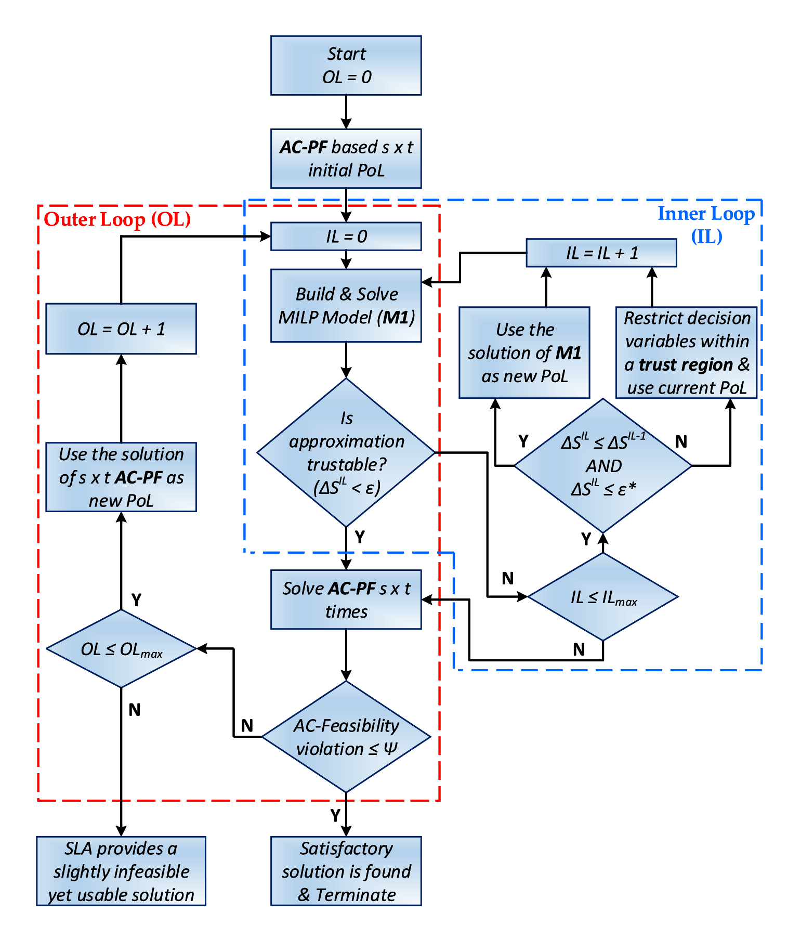
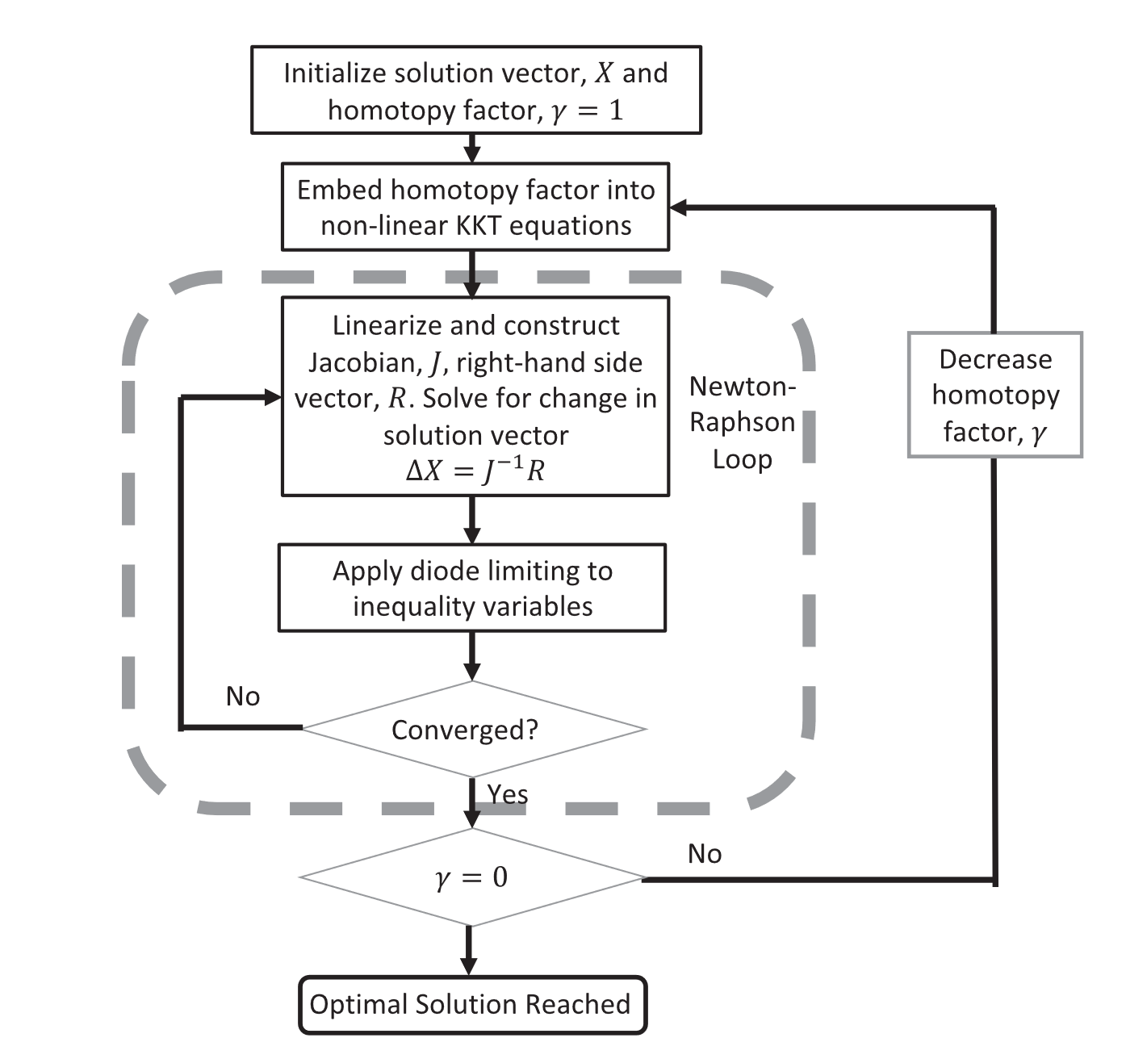
How do others ‘scalably’ solve it? – Linearized Solution, Iteratively Improved
Specifically,
… Approximations are made at the most modular form of OPF formulation [usman2022, usman2023] which itself could be within a loop, where some meta-parameters are adjusted based on successive iterative updates.
Some papers model these successive iterative updates on a homotopy based paradigm [agarwal2022]
MILP call inside a bigger algorithm
Some homotopy thing

Slide 15
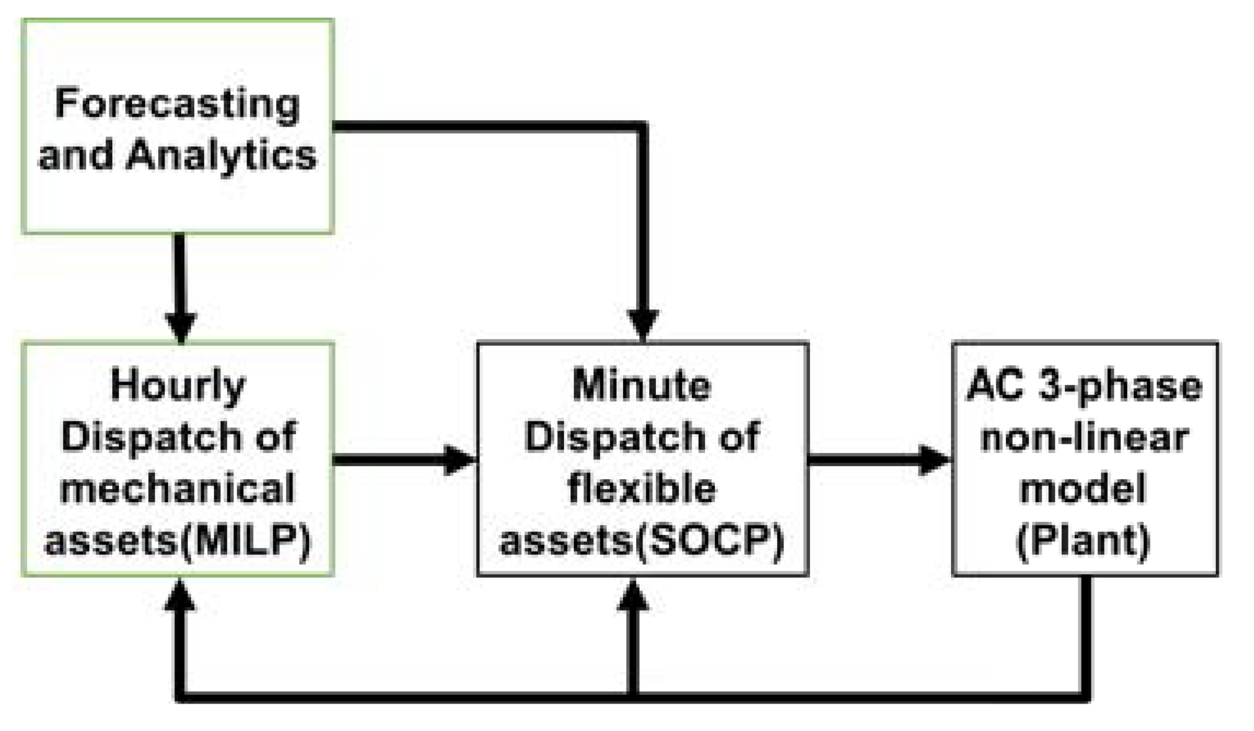
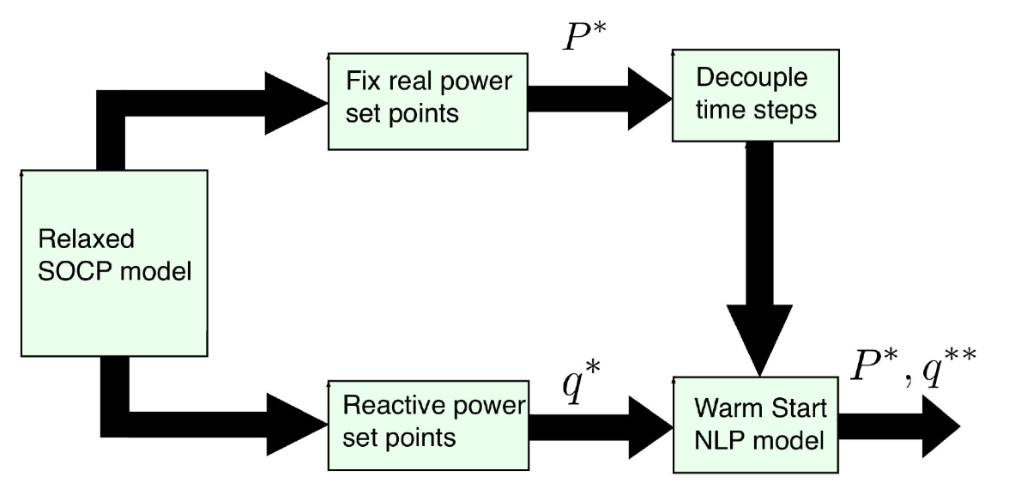
How do others ‘scalably’ solve it? – Hierarchical Optimization, Approximated (Relaxed) Top Level Step
Specifically,
The full optimization problem is divided into hierarchies, with the top hierarchy problem solving for an approximate (relaxed) model of the full horizon MINLP (NLP) problem.
Once the top-level problem is solved and set-points for temporally-coupling decision variables are obtained, the same decision variables are kept as constant for every single time-step’s OPF formulation.
The now temporally-decoupled Single-Period Optimal Power Flow Problems are formulated as SOCP (NLP) in a parallel manner.
[nazir2018 (nazir2020)]
Inner SOCP call within an outer MILP loop
Inner NLP call within an outer SOCP loop

Slide 16
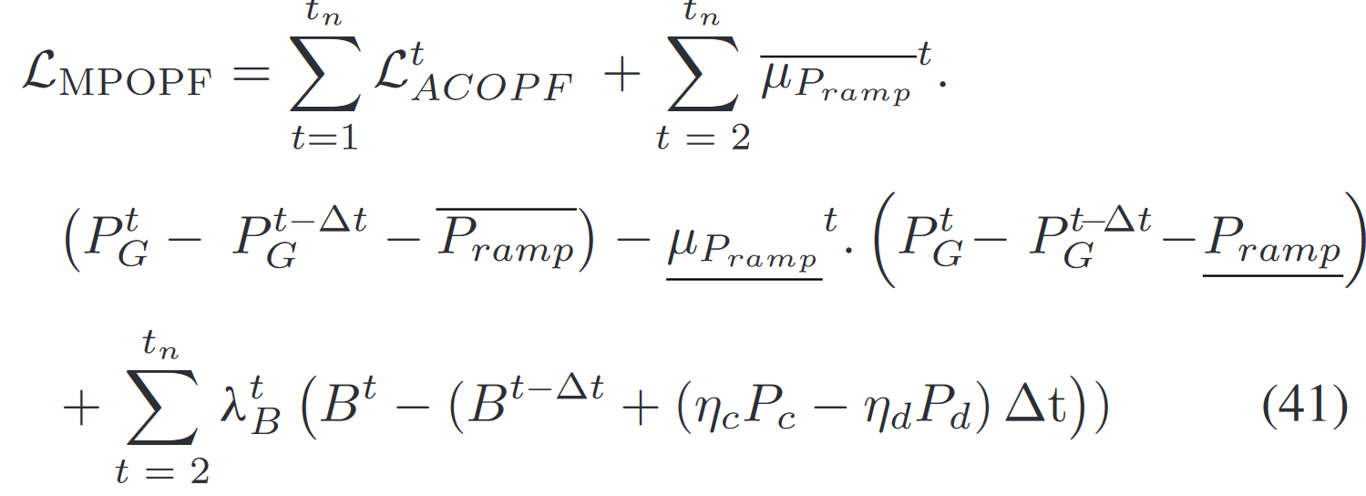
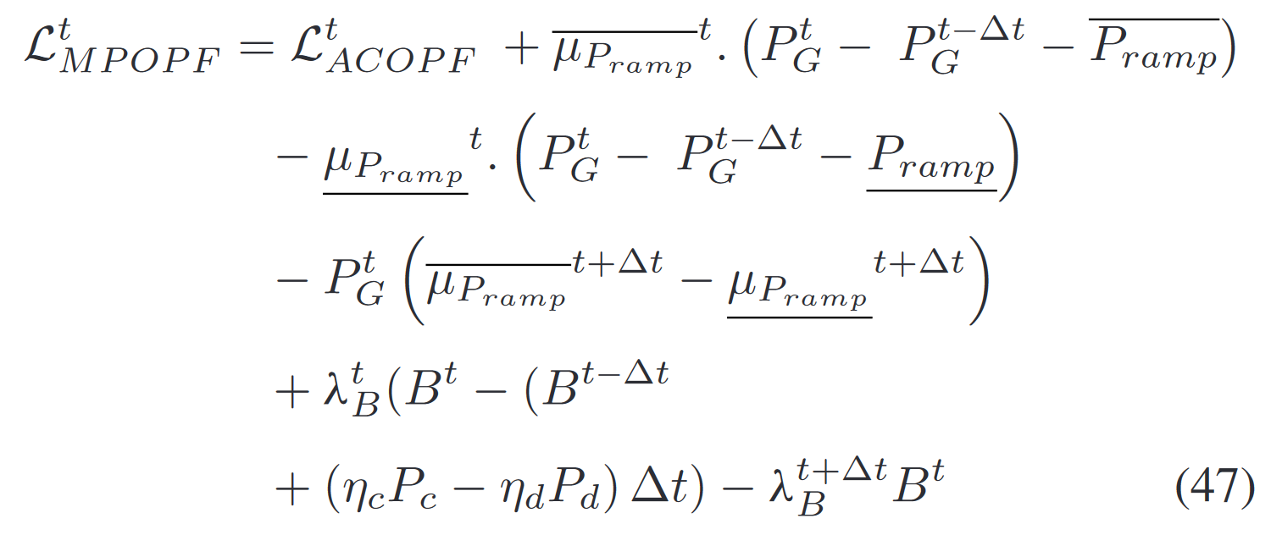
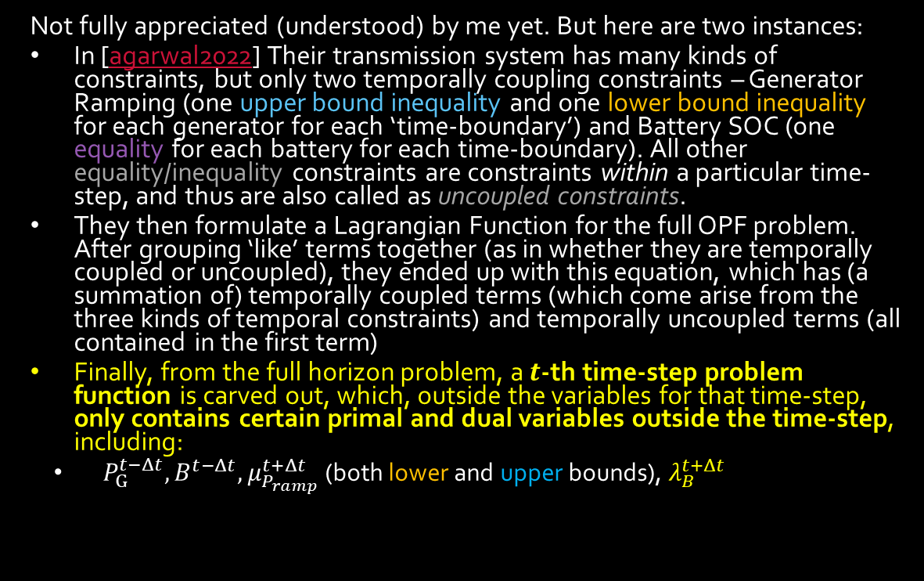
How do others ‘scalably’ solve it? – Some sort of Algorithms involving Primal Dual Decomposition of the Constraints containing Variables from different time-steps
Generator Ramping Constraints
Not fully appreciated (understood) by me yet. But here are two instances:
In [agarwal2022] Their transmission system has many kinds of constraints, but only two temporally coupling constraints – Generator Ramping (one upper bound inequality and one lower bound inequality for each generator for each ‘time-boundary’) and Battery SOC (one equality for each battery for each time-boundary). All other equality/inequality constraints are constraints within a particular time-step, and thus are also called as uncoupled constraints.
They then formulate a Lagrangian Function for the full OPF problem. After grouping ‘like’ terms together (as in whether they are temporally coupled or uncoupled), they ended up with this equation, which has (a summation of) temporally coupled terms (which come arise from the three kinds of temporal constraints) and temporally uncoupled terms (all contained in the first term)
Finally, from the full horizon problem, a $t$-th time-step problem function is carved out, which, outside the variables for that time-step, only contains certain primal and dual variables outside the time-step, including:
$P_{G}^{t−Δt}, B^{t−Δt}, μ_{P_{ramp}}^{t+Δt}$ (both lower and upper bounds), $λ_{B}^{t+Δt}$
Battery SOC Constraint
Lagrangian Function representing the full MPOPF problem (all time-steps)
Lagrangian Function representing the OPF problem for the $t$-th time-step. Notice that the ‘new’ blocks are just terms from the ‘existing’ blocks but coming from the adjacent time-steps to $t:\{t−Δt, t+Δt\}$

Slide 17
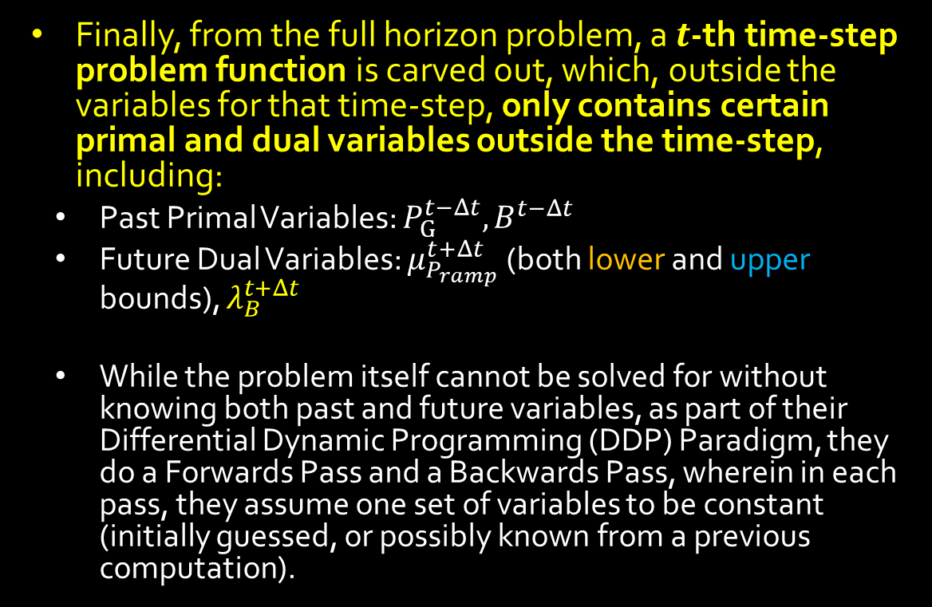
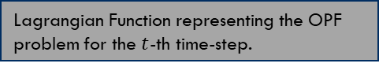
How do others ‘scalably’ solve it? – Some sort of Algorithms involving Primal Dual Decomposition of the Constraints containing Variables from different time-steps
Finally, from the full horizon problem, a $t$-th time-step problem function is carved out, which, outside the variables for that time-step, only contains certain primal and dual variables outside the time-step, including:
Past Primal Variables: $P_{G}^{t−Δt}, B^{t−Δt}$
Future Dual Variables: $μ_{P_{ramp}}^{t+Δt}$ (both lower and upper bounds), $λ_{B}^{t+Δt}$
While the problem itself cannot be solved for without knowing both past and future variables, as part of their Differential Dynamic Programming (DDP) Paradigm, they do a Forwards Pass and a Backwards Pass, wherein in each pass, they assume one set of variables to be constant (initially guessed, or possibly known from a previous computation).
Lagrangian Function representing the OPF problem for the $t$-th time-step.

Slide 18
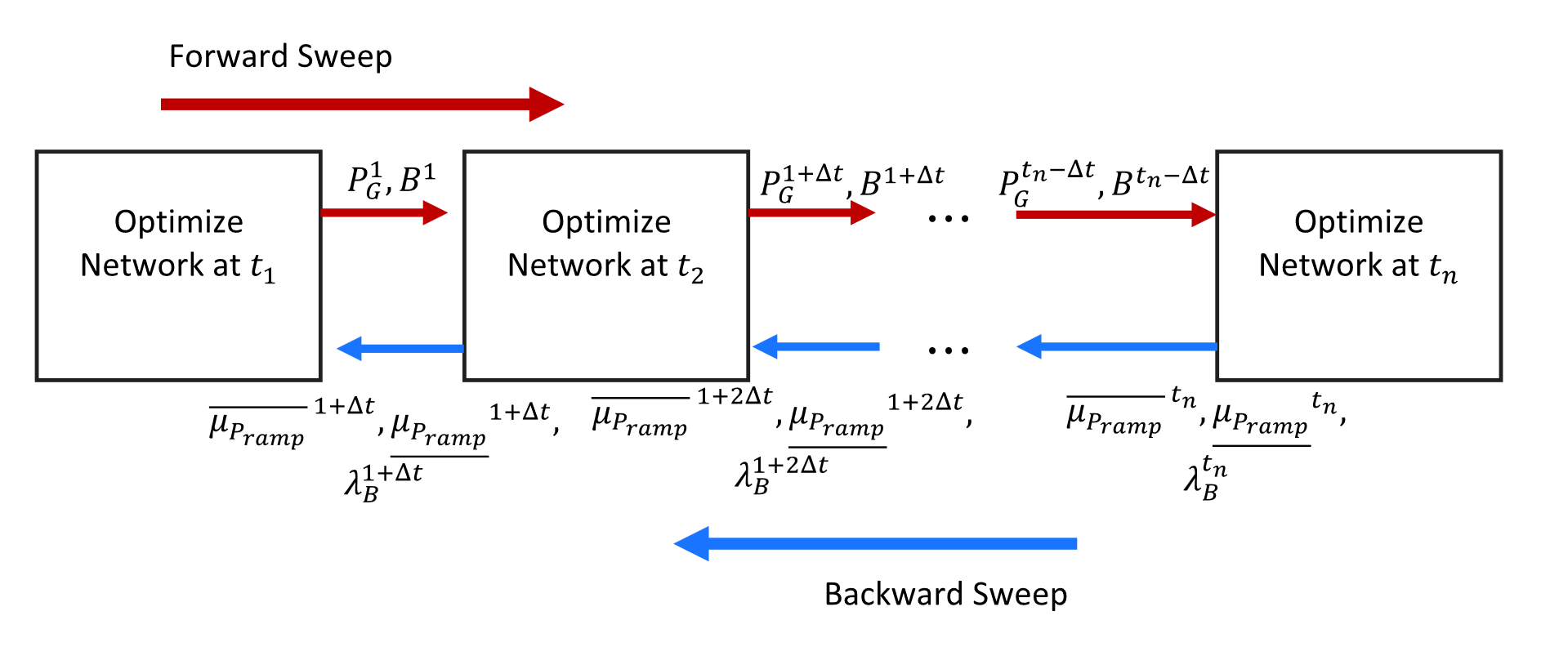
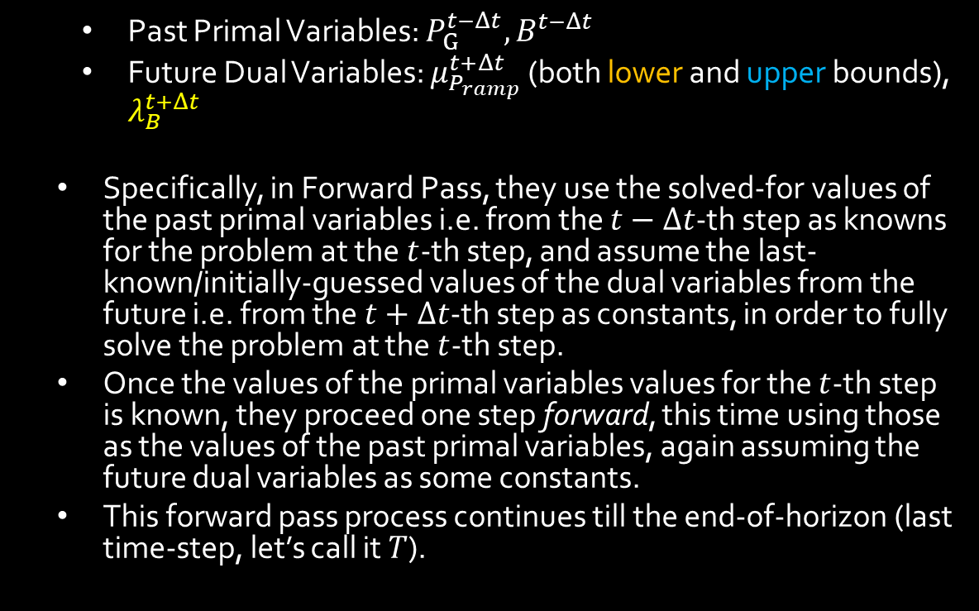
How do others ‘scalably’ solve it? – Some sort of Algorithms involving Primal Dual Decomposition of the Constraints containing Variables from different time-steps
Past Primal Variables: $P_{G}^{t−Δt}, B^{t−Δt}$
Future Dual Variables: $μ_{P_{ramp}}^{t+Δt}$ (both lower and upper bounds), $λ_{B}^{t+Δt}$
Specifically, in Forward Pass, they use the solved-for values of the past primal variables i.e. from the $t−Δt$-th step as knowns for the problem at the $t$-th step, and assume the last-known/initially-guessed values of the dual variables from the future i.e. from the $t+Δt$-th step as constants, in order to fully solve the problem at the $t$-th step.
Once the values of the primal variables values for the $t$-th step is known, they proceed one step forward, this time using those as the values of the past primal variables, again assuming the future dual variables as some constants.
This forward pass process continues till the end-of-horizon (last time-step, let’s call it $T$).
Lagrangian Function representing the OPF problem for the $t$-th time-step.
Scheme for Forward Pass and Backward Pass (here called ‘Sweep’ with no difference)

Slide 19
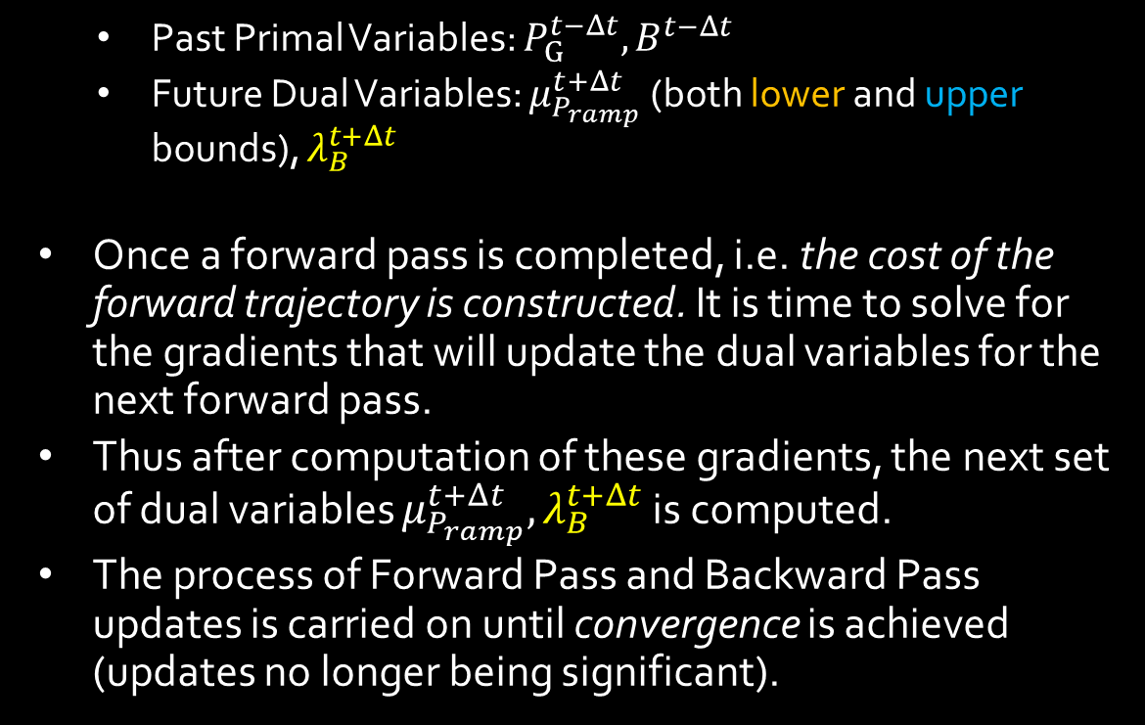
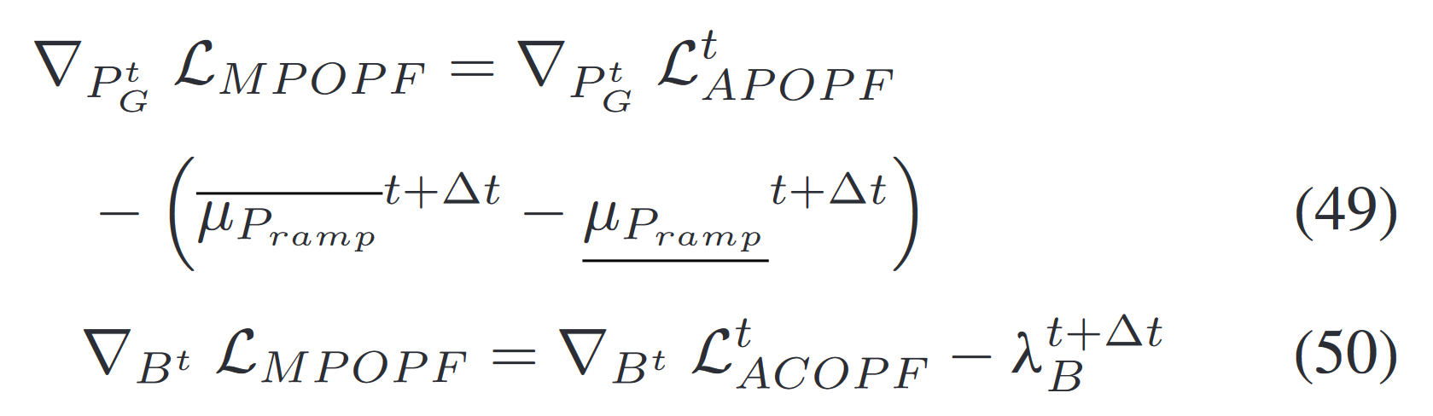
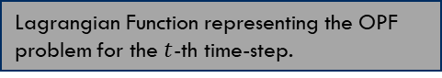
How do others ‘scalably’ solve it? – Some sort of Algorithms involving Primal Dual Decomposition of the Constraints containing Variables from different time-steps
Past Primal Variables: $P_{G}^{t−Δt}, B^{t−Δt}$
Future Dual Variables: $μ_{P_{ramp}}^{t+Δt}$ (both lower and upper bounds), $λ_{B}^{t+Δt}$
Once a forward pass is completed, i.e. the cost of the forward trajectory is constructed. It is time to solve for the gradients that will update the dual variables for the next forward pass.
Thus after computation of these gradients, the next set of dual variables $μ_{P_{ramp}}^{t+Δt},λ_{B}^{t+Δt}$ is computed.
The process of Forward Pass and Backward Pass updates is carried on until convergence is achieved (updates no longer being significant).
Lagrangian Function representing the OPF problem for the $t$-th time-step.
Scheme for Forward Pass and Backward Pass (here called ‘Sweep’ with no difference)
Equations used for updating the future dual variables as part of the Backward Pass

Slide 20
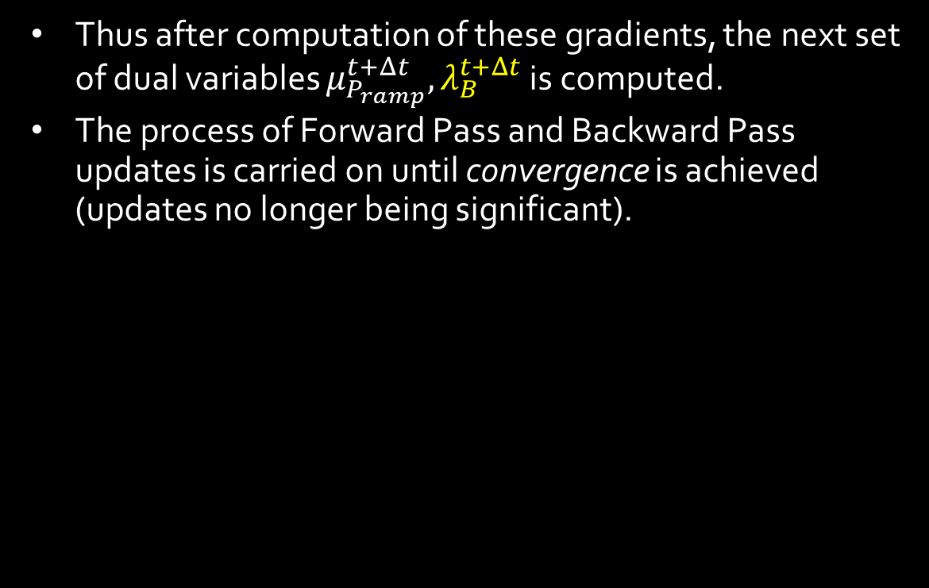
How do others ‘scalably’ solve it? – Some sort of Algorithms involving Primal Dual Decomposition of the Constraints containing Variables from different time-steps
Thus after computation of these gradients, the next set of dual variables $μ_{P_{ramp}}^{t+Δt},λ_{B}^{t+Δt}$ is computed.
The process of Forward Pass and Backward Pass updates is carried on until convergence is achieved (updates no longer being significant).
Lagrangian Function representing the OPF problem for the $t$-th time-step.
Done: I’ve understood the overall structure of a DDP implementation. Specifically, I’ve understood what is known, what is solved for, and what is assumed constant within a single time-period’s OPF. I understand the ‘Forward Pass’ component.
Current: I’m still studying the derivation required to understand the ‘Backward-Pass’ (how to use the gradient of the Lagrangian to get the dual variable updates). Once that is understood, I’ll have the understanding of one way to temporally decouple MPOPF for my use-case (ADS) as well, in a manner which can be implemented in code.
Scheme for Forward Pass and Backward Pass (here called ‘Sweep’ with no difference)
Equations used for updating the future dual variables as part of the Backward Pass

Slide 21
How do others ‘scalably’ solve it? – Some sort of Algorithms involving Primal Dual Decomposition of the Constraints containing Variables from different time-steps
A paper utilizing ADMM for temporal decomposition: [pinto2020]
Deficiencies:
I don’t understand how ADMM works, because I don’t understand how dual variables work.
To have a good understanding of dual variables, I have been reading up on theory [wolf2011]. I’ve gained some confidence in it but am yet to understand certain other key concepts thoroughly.
The plan is to understand dual variables [wolf2011]., understand ADMM, understand ADMM usage in OPF [peng2015] , ultimately understand ADMM in MPOPF [pinto2020]
.

Slide 22
A Novel Tractable Methodology to Stochastic Multi-Period AC OPF in Active Distribution Systems Using Sequential Linearization Algorithm
IEEE TRANSACTIONS ON POWER SYSTEMS, VOL. 38, NO. 4, JULY 2023
Muhammad Usman, Member, IEEE, and Florin Capitanescu, Member, IEEE
PostDoc (now at National Grid ESO); Senior Researcher at
Luxembourg Institute of Science and Technology (LIST), Luxembourg
Shortened as
SMPOPF in ADS using SLA – Usman, Capitanescu

Slide 23

One Page Overview
SMPOPF in ADS using SLA – Usman, Capitanescu
They model an ADS Grid with many kinds of components as an MINLP Problem (initially, for benchmarking) $M0$
They linearize the nonlinear terms of model $M0$ using Taylor’s Second Order Approximation into an MILP model $M1$
They then use a Sequential Linearization Algorithm (SLA) approach which successively improves the accuracy of the MILP model in an iterative manner.
They showcase the efficiency of their algorithm for day-ahead, hourly planning on small/medium radial and weakly-meshed systems such as IEEE$34$, UK$30$, Portuguese$191$ with caveats on feasibility error.

Slide 24

Overview of Paper - Modelling
SMPOPF in ADS using SLA – Usman, Capitanescu
They model an ADS Grid with many kinds of components, including:
Flexible Loads Renewable Energy Sources (RES) with reactive power and scope of curtailment $P_{j}^{0}, Q_{j}^{RES}, P_{j}^{curt}$
(FL) with overloading/ underloading ${P_{d_{j}}, Q_{d_{j}}, P}_{j}^{od}, P_{j}^{ud}$
Electrical Energy Storages (EES) (without reactive power) $P_{j}^{ch}, P_{j}^{dch}, B_{j}$
On Load Tap Changer Transformers (OLTC) $λ_{if}^{k}, μ_{ij}^{k}$
as an MINLP Problem (initially, for benchmarking) which they label as $M0$

Slide 25
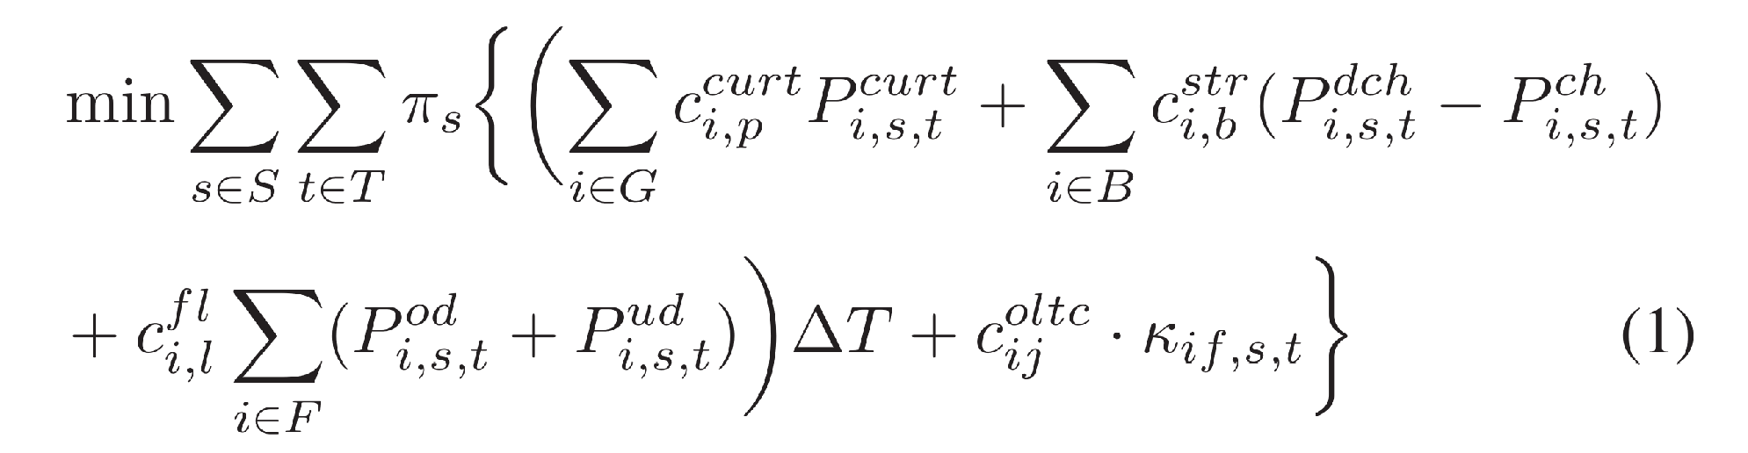
Overview of Paper - Modelling
SMPOPF in ADS using SLA – Usman, Capitanescu
All component control functions have some cost associated with them.
Objective: Minimize the cost of network operations. cost of controlling ADS components, including FLs, RESs, EESs, OLTCs.

Slide 26

Numerical Results
SMPOPF in ADS using SLA – Usman, Capitanescu
Three systems:
IEEE $34$ bus $12.66 kV$radial ADS
UK $30$ bus $11 kV$ weakly-meshed ADS
Portuguese $191$ bus $30 kV$ radial ADS
Horizon: $24$ hours (hourly-time period)
$10$ Uncertainty Scenarios of solar and wind DERs

Slide 27
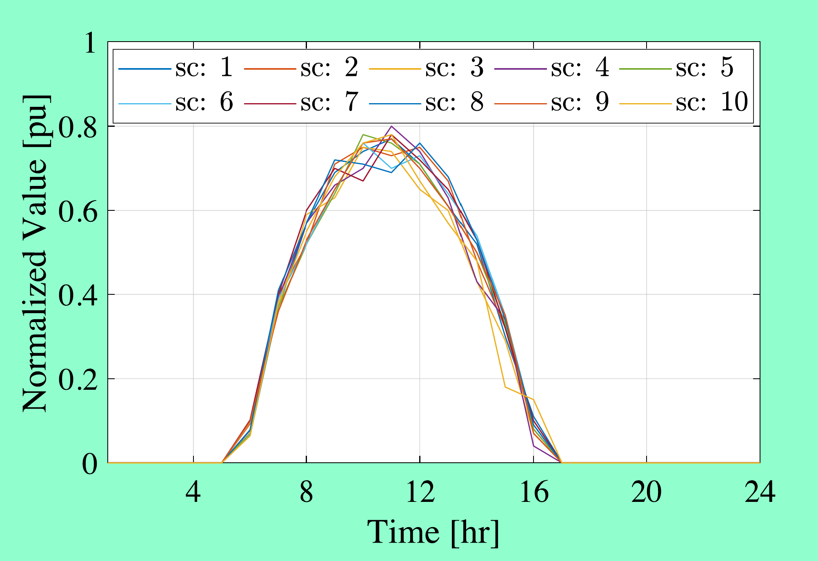
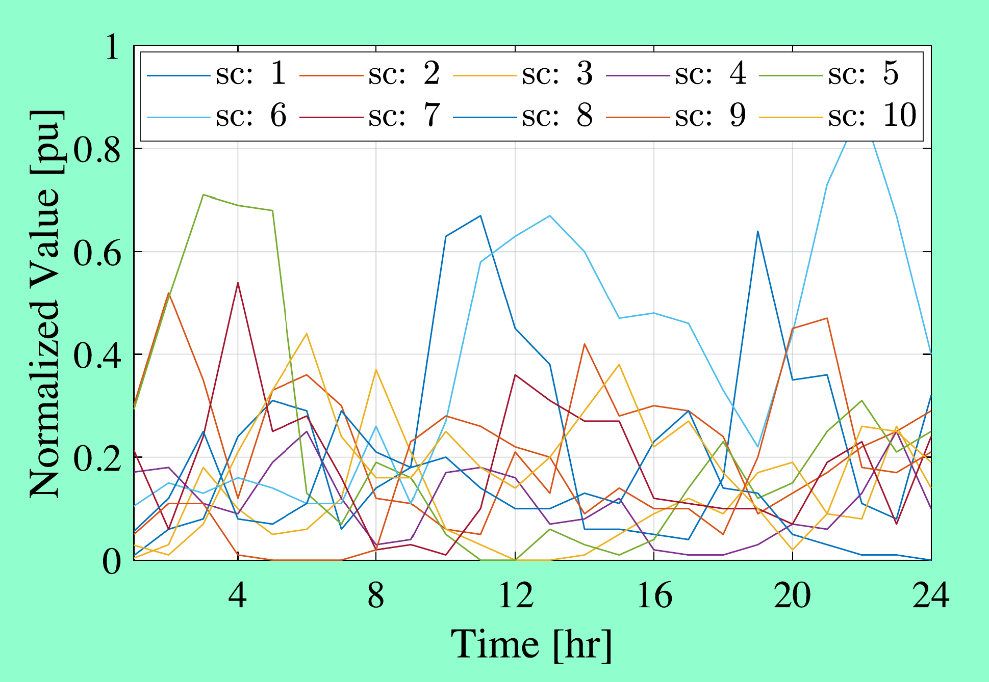

Numerical Results
SMPOPF in ADS using SLA – Usman, Capitanescu
Three systems:
IEEE $34$ bus $12.66 kV$radial ADS
UK $30$ bus $11 kV$ weakly-meshed ADS
Portuguese $191$ bus $30 kV$ radial ADS
Horizon: $24$ hours (hourly-time period)
$10$ Uncertainty Scenarios of solar and wind DERs
PVs are less variable
Wind profile is pretty variable.
PV Scenarios
Wind Scenarios

Slide 28
Flexibility Options (FOs)
SMPOPF in ADS using SLA – Usman, Capitanescu
FO1: Active Power Curtailment (APC). (APC-FO1)
FO2: APC + OLTC
FO3: APC + Adaptive Power Factor (APF-FO3)
FO4: APC + APF + OLTC
FO5: APC + EESs
FO6: APC + FLs
FO7: APC + EESs + FLs
FO8: APC + EESs + FLs + APF
FO9: APC + EESs + FLs + APF + OLTC

Slide 29

Parameters
SMPOPF in ADS using SLA – Usman, Capitanescu
Maximum Inner-Loop Iterations: $IL_{max}=3$
Maximum Outer-Loop Iterations: $OL_{max}=5$
Trustable Approximation Criterion: $ε={10}^{−3} pu≡1 kVA$ error value (between non-linear MPOPF and its linear approximation)
$ε^{∗}={10}^{−1} pu$ to switch to trust region path in the inner-loop.
AC Feasibility threshold $ψ=1\%$ (i.e. Nodal voltage/Branch current violation above $1\%$ is considered infeasible)
Benchmark MINLP $M0$ solved via BONMIN (ratio gap = $0.05$, allowable gap = $0.01$)
Proposed MILP Model $M1$ solved via CPLEX
Modelling for both models done in Julia/JuMP environment.

Slide 30
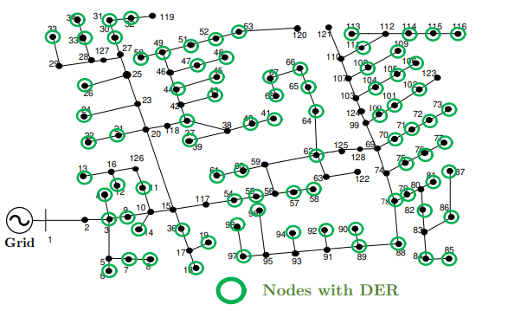
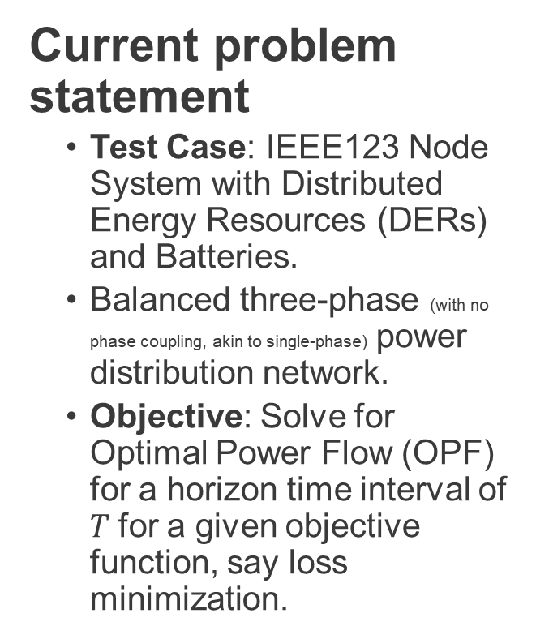
Network being tested on
Current problem statement
Test Case: IEEE123 Node System with Distributed Energy Resources (DERs) and Batteries.
Balanced three-phase (with no phase coupling, akin to single-phase) power distribution network.
Objective: Solve for Optimal Power Flow (OPF) for a horizon time interval of $T$for a given objective function, say loss minimization.

Slide 31
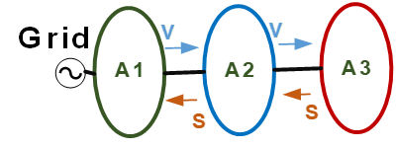
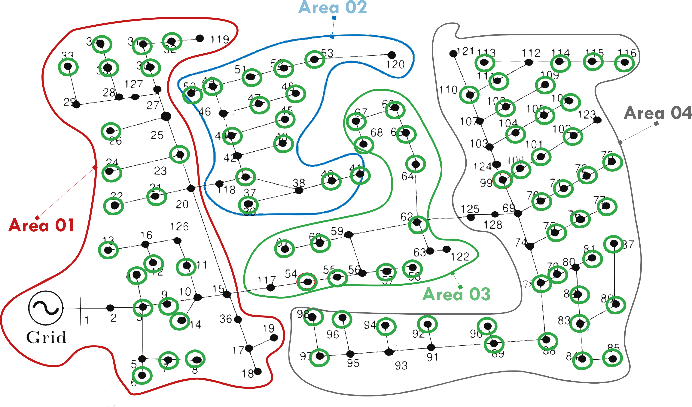


Network being tested on
A previous model of the test system. Currently the system has DERs and Batteries on $100\%$ of the nodes with non-zero loads.
ENApp Approach [1]
Divide the network into several areas to solve for their Optimal Power Flow solutions separately, with exchange of boundary variables after every ‘macro-iteration’.

Slide 32

Overall Scope of the problem Algorithm and Communication Architecture
OpenDSO-System Operator (Forecast)
OpenDSO-Measurement Devices
OpenDSO-EDO
OpenDSO-OpenDSO

Slide 33

A simpler schematic for D-OPF.

Slide 34


A simpler schematic for MP-D-OPF for three time-steps
($T=3)$

Slide 35

What is currently being done? MP-DOPF in Brute Force

Slide 36



What is will be done? A ‘true’ MP-DOPF using Differential Dynamic Programming (Currently under formulation, variables not explained here) [20b]
$$μ_{1}$$
$$μ_{2}$$

Slide 37

Multi-Period D-OPF simulation of a grid with DERs and Battery Storage

Slide 38

Problem Statement
Given the State of Charges of all batteries in a grid at the beginning of a horizon interval ($B_{j}^{0}, j∈ ℬ, ℬ$ representing the set of nodes with Batteries$)$, along with predictions for other non-controllable parameter values like $P_{Load}^{t}, P_{DER}^{t} ∀ t∈\left[0, T\right]$:
Solve for Optimal Power Flow of the system, with the objective of minimizing line losses across the entire horizon of time interval $T$

Slide 39

Problem Statement
Given the State of Charges of all batteries in a grid at the beginning of a horizon interval ($B_{j}^{0}, j∈ ℬ, ℬ$ representing the set of nodes with Batteries$)$, along with other non-controllable parameter values like $P_{Load}, P_{DER}$:
Solve for Optimal Power Flow of the system, with the objective of minimizing line losses across the entire horizon of time interval $T$
while making sure that:
1. $B_{t}$ (the SOC of the battery at every point of the simulation) stays in permissible limits
2. The OPF Solution is physically consistent. For no node containing a battery, is $P_{d}^{t}. P_{c}^{t}≠0$. In other words, make sure that Complementarity of Discharging and Charging is ensured. Alternatively, Simultaneous Charging and Discharging (SCD) is avoided.
3. Other usual OPF physical constraints are also satisfied.
4. Terminal SOC is same as initial.

Slide 40

Simulation Parameters
Objective: Minimize Line Losses
System: IEEE $123$ Node System
Phase: Balanced $3∅$
Supply: DERs and Batteries at select (about $50\%$ of total) nodes. Substation.
Demand: Flat line (will be made varying each time-step in future simulations)
Control: Inverter Reactive Power Control for DERs and Batteries. Battery Charging/Discharging.
Number of discrete time-steps: $T≤8$
Duration per time-step: $Δt=1 h$.

Slide 41


Optimization Formulation
(Integer-Constraint Relaxed) Non-linear Optimization Problem: BFM Constraints with Battery and DER decision variables.
Line Losses
Real Powerflow from a bus into the network
Reactive Powerflow from a bus into the network
Kirchhoff's Voltage Law (KVL)
Current Magnitude in a branch

Slide 42

Optimization Formulation
(Integer-Constraint Relaxed) Non-linear Optimization Problem: BFM Constraints with Battery and DER decision variables.
Line Losses
DER Inverter Reactive Power
Nodal Voltage Limits

Slide 43

Optimization Formulation
(Integer-Constraint Relaxed) Non-linear Optimization Problem: BFM Constraints with Battery and DER decision variables.
Line Losses
Battery State of Charge Equation (this equation is temporally coupled, or has ‘memory’)

Slide 44

Optimization Formulation
(Integer-Constraint Relaxed) Non-linear Optimization Problem: BFM Constraints with Battery and DER decision variables.
Line Losses
Battery Charging and Discharging Power Limits
Battery Inverter Reactive Power Limits
Battery SOC Permissible Limits

Slide 45

Optimization Formulation
(Integer-Constraint Relaxed) Non-linear Optimization Problem: Tweaking the Objective Function to satisfy some more constraints.
Line Losses
Ensures Complementarity of Charging and Discharging, or alternatively, ensure there’s no SCD.
For minimizing the deviation between end-of-day battery SOC and a reference SOC.

Slide 46


Optimization Formulation
(Integer-Constraint Relaxed) The Full Non-linear Optimization Problem
Line Losses
For minimizing the deviation between end-of-day battery SOC and a reference SOC.
Ensures Complementarity of Charging and Discharging, or alternatively, ensure there’s no SCD.
Real Powerflow from a bus into the network
Battery State of Charge Equation (temporally coupled) with complementarity relaxed.
Reactive Powerflow from a bus into the network
#Types of variables
$$9T$$
#Variables
$$4mT+n_{DERT}T+4n_{Batt}T$$
#Equality Constraints $4mT+n_{Batt}T$
(Non-Linear)
Kirchhoff's Voltage Law (KVL)
Current Magnitude in a branch
DER Generation (forecasted, non-controllable)
Loads (forecasted, non-controllable)

Slide 47

Current Status of Simulation and Results
What has been done
A variety of simulation runs have been modelled and run for the sake of benchmarking including:
Centralized OPF with and without batteries ($T$ time-steps).
Distributed* OPF with and without batteries. ($T \text{time}\text{−}\text{steps}, 4$ Areas)
*Spatially Distributed Computation, Brute-forced Temporal Computation.
Previous: Distributed OPF with batteries in a greedy “minimize losses right this time-period, for every time-period” manner. ($4$ Areas, $T$ time-steps)

Slide 48

Results: Boundary Variables
$P_{Losses}$vs $t$

Slide 49



Results: Boundary Variables
$P_{12}$vs $t$

Slide 50



Results: Boundary Variables
$V_{1}$ vs $t$

Slide 51


Current Status of Simulation and Results
SCD Plots to check Physical validity of Distributed MPOPF
This simulation was done for 5 time-steps (but the algorithm is scalable, and I’ve done them for 10, 15 time-steps. But the time taken by the brute force algorithm grows exponentially with number of time steps)
Charging and Discharging are always Complementary.
Terminal SOC is almost the same as initial SOC

Slide 52


Current Status of Simulation and Results
Results for $123$ Node System from Centralized MPOPF
The plot shown is typical of the charging/discharging cycle for most batteries in the area.
This simulation was done for 5 time-steps (but the algorithm is scalable, and I’ve done them for 10, 15 time-steps. But the time taken by the brute force algorithm grows exponentially with number of time steps)
Charging and Discharging are always Complementary.
Terminal SOC is almost the same as initial SOC
IEEE $123$ Node System modelled here has $85$ nodes with Nodes and DERs and Batteries.

Slide 53

Current Status of Simulation and Results
Results for $123$ Node System from Centralized MPOPF

Slide 54
Conclusion and Discussion
Major Observations:
Batteries were modelled correctly, i.e. no Simultaneous Charging and Discharging was observed.
Terminal SOC values (SOC values at end of day) mostly kept close to the original SOC values (beginning of day).

Slide 55

Bounds and Values
Battery State/Control Variables (1/2)

Slide 56

Bounds and Values
Battery State/Control Variables (2/2)

Slide 57

Bounds and Values
BFM and DER State/Control Variables

Slide 58

Reference of Notation: Battery Variables

Slide 59

Reference of Notation: BFM and DER Variables

Slide 60

Reference of Notation: Grid-level Notation
Helpful for clarifying any variable in the optimization formulations.

Slide 61

Reference of Notation: Branch Flow Model and DER variables
Helpful for clarifying any variable in the optimization formulations.

Slide 62




(IEEE 123 System divided into) 4 Area System

Slide 63

[In development] Simulation Process of Spatially and Temporally Decomposed OPF algorithm.
start
------------------------------------------------------------------------
Known:
$B_{j}^{0}, P_{DER_{j}}^{t}, P_{Load_{j}}^{t} ∀ t∈\left[0, T\right], j∈Ν$
-----------------------------------------------------------------------
while “temporal boundary variables are NOT equal in value for all consecutive time intervals”
while “spatial boundary variables are NOT equal in value for all connected parent-child areas”
Run (D-)OPF for minimizing the losses across the horizon for each area, in parallel. This is called as a macro-iteration.
Exchange spatial boundary variables between all sets of connected parent-child areas.
end
Exchange temporal boundary variables between consecutive time intervals
end
------------------------------------------------------------------------
stop

Slide 64

Optimization Formulation
Mixed-Integer Non-linear Optimization Problem (in built-complementarity, but harder to solve)
Line Losses
Battery State of Charge Equation (this equation is temporally coupled, or has ‘memory’)
Real Powerflow from a bus into the network
Reactive Powerflow from a bus into the network
Kirchhoff's Voltage Law (KVL)
Current Magnitude in a branch
Complementarity of Charging and Discharging during a particular time interval.
DER Generation (forecasted, non-controllable)
Loads (forecasted, non-controllable)

Slide 65
Multi-Period D-OPF simulation of a grid with DERs and Battery Storage
Naïve Brute-Force approach to MPOPF being implemented (Solve for the full problem for the full horizon in one go).

Slide 66


Optimization Formulation
The Full Optimization Problem for Brute-Force MPOPF
#Types of variables
$$9T$$
#Variables
$$4mT+n_{DERT}T+4n_{Batt}T$$
#Equality Constraints $4mT+n_{Batt}T$
(Non-Linear)

Slide 67

Optimization Formulation
The Full Optimization Problem for Brute-Force MPOPF
#Types of variables
$$9T$$
#Variables
$$4mT+n_{DERT}T+4n_{Batt}T$$
#Equality Constraints $4mT+n_{Batt}T$
(Non-Linear)

Slide 68



Optimization Formulation
The Full Optimization Problem
SCD Term (Green Box)
Fixed values $P_{Load}, P_{DER}$ accounted for into $p_{j}$.
#Types of variables
$$9$$
#Variables
$$4m+n_{DER}+4n_{Batt}$$
#Equality Constraints $4m+n_{Batt}$
(Non-Linear)

Slide 69

Optimization Formulation
Will happen when every node has a DER and a Battery
The Full Optimization Problem: Linear Objective, Non-Linear Constraint
SCD Term (Green Box)
Fixed values $P_{Load}, P_{DER}$ accounted for into $p_{j}$.
Most Complicated Scenario Possible
#Types of variables
$$9$$
#Variables
$$9m$$
#Equality Constraints $5m$ (Non-Linear)

Slide 70

Optimization Formulation
Want to start with a good initialization for all $9$ state/control variables.
So should solve for some ‘simpler’ Optimization Problems.
The Full Optimization Problem: Linear Objective, Non-Linear Constraint
Most Complicated Scenario Possible
#Types of variables
$$9$$
#Variables
$$9m$$
#Equality Constraints $5m$ (Non-Linear)

Slide 71


Optimization Formulation
Start with removing some terms form the problem.
We hope to get good initialization values for the more complex problems.
Making a simpler Optimization Problem
Most Complicated Scenario Possible
Typo. Signs are flipped.
#Types of variables
$$9$$
#Variables
$$9m$$
#Equality Constraints $5m$ (Non-Linear)
Typo: Times are actually $t$ and $t−1$ instead of $t+1$ and $t$

Slide 72

Optimization Formulation
Class of Variable | Reason for Ignoring
 | Removing Losses makes model linear.
 | Side effect of the combined effect of current SCD term and type of objective function. Not including the Green Box Term can cause SCD. But adding the Green Box term without any loss term in the objective function basically penalizes any kind of battery participation.
Current/Loss Term
Making a simpler Optimization Problem
Battery Variables
Most Complicated Scenario Possible
Typo. Signs are flipped.
#Types of variables
$$9$$
#Variables
$$9m$$
#Equality Constraints $5m$ (Non-Linear)
Typo: Times are actually $t$ and $t−1$ instead of $t+1$ and $t$

Slide 73



Optimization Formulation
Initialization Step 1a: Feasibility on Linear Constraints
#Types of variables
$$4$$
#Variables
$$3m+n_{DER}$$
#Equality Constraints $3m$ (Linear)
Get feasible values of $v_{j}, P_{ij}, Q_{ij}, q_{D_{j}}$

Slide 74

Optimization Formulation
Initialization Step 1a: Feasibility on Linear Constraints
Most Complicated Scenario Possible
#Types of variables
$$4$$
#Variables
$$4m$$
#Equality Constraints $3m$ (Linear)
Get feasible values of $v_{j}, P_{ij}, Q_{ij}, q_{D_{j}}$

Slide 75


Optimization Formulation
Initialization Step 1b: Quadratic Objective, Linear Constraints
#Types of variables
$$8$$
#Variables
$$3m+n_{DER}+4n_{Batt}$$
#Equality Constraints $3m+n_{Batt}$ (Linear)

Slide 76



Optimization Formulation
A ‘fake’ line-loss function. We don’t want to involve $l_{ij}$ already as we’re yet to get good initialization for any of the Battery Variables.
We use $v_{j}$ results from Initialization Step $1a$. We can’t involve $v_{j}$ as an optimization variable as that would make the ‘fake’ loss minimization function non-convex.
Initialization Step 1b: Quadratic Objective, Linear Constraints
#Types of variables
$$8$$
#Variables
$$3m+n_{DER}+4n_{Batt}$$
#Equality Constraints $3m+n_{Batt}$ (Linear)

Slide 77

Optimization Formulation
Initialization Step 1b: Quadratic Objective, Linear Constraints
Most Complicated Scenario Possible
#Types of variables
$$8$$
#Variables
$$8m$$
#Equality Constraints $4m$ (Linear)

Slide 78

Bounds and Values
Battery State/Control Variables

Slide 79


Bounds and Values
$α$ – The Coefficient for the Green Box term penalizing SCD

Slide 80



Results: Real Power Losses
$P_{Losses}, P_{Subs}$ vs $t$
While batteries have charge to spare, the losses are minimized, as less power needs to flow all the way from the substation.
Here, for the first $4$ time-periods, or $60 min.$, the batteries are able to discharge at their maximum capacity, and so the line losses are significantly lower. By $6$ time-periods, they completely run out of SOC (reach minimum value of SOC), and the losses return to ‘normal’, pre-battery configuration.

Slide 81




A metric for quantifying effect of storage and DER power on the grid.
$$P_{Save}$$
$P_{12}:$Power flowing into the area indirectly via the substation (directly for Area 1).
$P_{Save}↑ →$More savings in losses and substation power through batteries.
$P_{DER}:$Solar generated power for the whole area.
$P_{d} −P_{c}:$Net real power injected into the area via batteries.

Slide 82


Results: Reactive Power Losses
$Q_{Losses}, Q_{Subs}$ vs $t$
Investigate further. I thought that since batteries don’t generate Real Power when they run out of SOC, they should generate more reactive power. I guess more real power flow is highly coupled with more reactive power flow? Need to check $q_{D_{j}}$ values.

Slide 83



Results
$t_{Optimization}$ vs $t$
Machine dependent AND still varies every run.
To do: Clarify the values in the plot and the ones in the logs. How exactly are they different again?
My personal machine
My Lab machine

Slide 84

Results
$P_{Save}$ vs $t$

Slide 85



Results: Boundary Variables
$P_{12}, Q_{12}, V_{1}$ vs $t$
As expected.
Investigate: Negative Reactive Power Flowing from Area 1 to Area 3 and Area 2 to Area 4? Check reactive generation values for the areas.

Slide 86





Results: Battery Variables
$B_{j}(t)$, $P_{c_{j}}, P_{c_{j}}$vs $t$
This plot is for one battery, specified by an Area $\#$ and Node $\#$ (for that area).
The plots for other batteries are near identical, as only SOC percentages have been plotted instead of absolute battery charge in $kWh$
Batteries initially discharge at maximum rate, which helps in:
Loss Minimization
Voltage Deviation Minimization (not explicitly solved for, but noted from the plots of node voltages)
until they reach their minimum permissible SOC.
Zero charging. (will plot $P_{d}, P_{c}$ together later to clearly highlight that)

Slide 87

Results
Multi-Period D-OPF of IEEE $123$Node System
Simulation went in an intuitive manner.
Batteries ONLY discharged. They kept discharging until their State of Charge $B_{j}^{t}$ dipped to the minimum permissible value of $B_{min}=0.30E_{Rated}$ , i.e.
$P_{d_{j}}^{t}≥0, P_{c_{j}}^{t}=0 ∀j∈ℬ, t∈[1, K]$. This is intuitive, as for a greedy minimization of line-losses with no perspective of any future opportunity costs for not being able to discharge, the batteries have no incentive to charge, and all the incentive to discharge.
Other variables depend on the above fact. For the first $5$ time-periods ($75 mins$ of simulation-time), while the batteries haven’t run out of charge, line losses $P_{Loss}$, Substation Power $P_{Subs}$ are kept significantly lower, and savings due to batteries $P_{Save}$ is high for every area. By the $6^{th}, 7^{th}$time-periods, $P_{Loss}, P_{Subs}$ soar to ‘battery-less’ levels, an $P_{Save}$ drops to a low, constant value.

Slide 88

Takeaways
The cost of replacing the Boolean Constraints with the SCD Green Box term for avoiding SCD.
Handle SCD (Green Box) term with care.
While it has helped us relax the constraint of Boolean Variables in the optimization modelling and solving, it needs extra caution for modelling in order to arrive at a useful solution.
For example, it cannot be used alone without the main objective function, such as loss minimization. Otherwise, the optimizer will penalize any participation of the batteries, making both $P_{C_{j}}=0$and $P_{D_{j}}=0$for all batteries.
$α$ needs to be carefully designed. The value of the SCD Green Box should be within a magnitude range of the line loss function’s value. Too greater, and it would reduce battery power to zero, too low, and SCD might occur.

Slide 89

Takeaways
The cost of replacing the Boolean Constraints with the SCD Green Box term for avoiding SCD.
However, if we use an economic based model, which assigns a cost to substation power and battery charging/discharging, then the number of optimization steps can be reduced to just two, with one initialization with no line losses, as$P_{12}$ is a state variable itself which does not require any other non-linear equality constraint term like $l_{ij}$.
But in that case, we need to clarify who owns the storage (cite that paper), as the coefficient for cost function of battery charging/discharging could then be either positive or negative (how?).

Slide 90
Reference of Notation

Slide 91

Reference of Notation
Helpful for clarifying any variable in the optimization formulations.

Slide 92





Battery Models Used in Various Papers
SOC is always taken as $pu$ energy (base $= kWh/MWh$)
Large Scale Multi-Period Optimal Power Flow With Energy Storage Systems Using Differential Dynamic Programming
Ensures Complementarity (i.e., ensures absence of SCD) without any additional boolean constraints.
They prefer rectangular coordinates for all complex variables, for usage in Newton Raphson method.

Slide 93
Battery Models Used in Various Papers
Large Scale Multi-Period Optimal Power Flow With Energy Storage Systems Using Differential Dynamic Programming
All variables are Continuous
No Discrete variables
No Boolean variables
In the final equations

Slide 94



Battery Models Used in Various Papers
Receding-Horizon Optimization of Unbalanced Distribution Systems with Time-Scale Separation for Discrete and Continuous Control Devices
Two Optimization Loops (Time-scales): An ‘Outer’, slower MILP loop for fixing battery SOC values and STL element values.
An ‘Inner’, faster SOCP loop for solving for optimal power flows.
Battery apparent power (through inverter) limits.

Slide 95
Battery Models Used in Various Papers
Receding-Horizon Optimization of Unbalanced Distribution Systems with Time-Scale Separation for Discrete and Continuous Control Devices
Two Optimization Loops (Time-scales): An ‘Outer’, slower MILP loop for fixing battery SOC values and STL element values.
An ‘Inner’, faster SOCP loop for solving for optimal power flows.
Battery apparent power (through inverter) limits.

Slide 96

Battery Models Used in Various Papers
Upon addition of the green block, the grey terms are removed from the constraints.
Receding-Horizon Optimization of Unbalanced Distribution Systems with Time-Scale Separation for Discrete and Continuous Control Devices
The yellow block ensures that the terminal battery SOC value (i.e. SOC value at the end of the horizon) prescribed by the outer loop is adhered to.
$P_{n}^{q},_{t}$ is also an optimization (control) variable

Slide 97
Battery Models Used in Various Papers
Receding-Horizon Optimization of Unbalanced Distribution Systems with Time-Scale Separation for Discrete and Continuous Control Devices
All variables are Continuous
No Discrete variables
No Boolean variables
In the final equations

Slide 98
Battery Models Used in Various Papers
Battery models themselves are the same.
Optimal Multi-Period Dispatch of Distributed Energy Resources in Unbalanced Distribution Feeders
Also, NO yellow term this time.
For a system WITHOUT any STL elements, instead of a (MI , SOCP) loops, they use (SOCP, NLP) loops.
All variables are Continuous
No Discrete variables
No Boolean variables
In the final equations

Slide 99

Battery Models Used in Various Papers
Battery models themselves are the same.
Optimal Multi-Period Dispatch of Distributed Energy Resources in Unbalanced Distribution Feeders
Also, NO yellow term this time.
For a system WITHOUT any STL elements, instead of a (MI , SOCP) loops, they use (SOCP, NLP) loops.
All variables are Continuous
No Discrete variables
No Boolean variables
In the final equations

Slide 100

Battery Models Used in Various Papers
Battery Dispatching for End Users With On-Site Renewables and Peak Demand Charges – An Approximate Dynamic Programming Approach
Initial thoughts: It uses a linear/linearized model of the battery, and all equations are expressed with matrices.
Details to be added later.

Slide 101
Differential Dynamic Programming for Multistage Uncertain Optimal Control
Seventh International Joint Conference on Computational Sciences and Optimization (2014)
Xiaodong Qian and Yuanguo Zhu
Deptt. Of Appl. Math.
Nanjing University of Science and Technology (NUST)
Professor with the Department of Mathematics
NUST, Nanjing, China
Has 1 citation – by the SUGAR-DDP paper by Agarwal and Pileggi

Slide 102

Differential Dynamic Programming for Multistage Uncertain Optimal Control
Starting with an expression for the Cost-to-go function for an Uncertain Optimal Control Problem.

Slide 103


Differential Dynamic Programming for Multistage Uncertain Optimal Control
In about $41$ equations, it provides an algorithm for solving a stochastic MPC problems using Differential Dynamic Programming (DDP). It initializes the solution using an unspecified Genetic Algorithm (GA).

Slide 104

Differential Dynamic Programming for Multistage Uncertain Optimal Control
Key equations required for Step 1 of the algorithm:

Slide 105




Differential Dynamic Programming for Multistage Uncertain Optimal Control
Key equations required for Step 2 of the algorithm:

Slide 106



Differential Dynamic Programming for Multistage Uncertain Optimal Control
Key equations required for Step 3 of the algorithm:
Given in another reference.

Slide 107

Differential Dynamic Programming for Multistage Uncertain Optimal Control
At the end it also gives a numerical example utilizing the algorithm.

Slide 108

Differential Dynamic Programming for Multistage Uncertain Optimal Control
It uses Genetic Algorithms for Initializing the solution.
Given in another reference.

Slide 109

Differential Dynamic Programming for Multistage Uncertain Optimal Control
Utilizing the key derived equations for the algorithm for this specific problem:

Slide 110

Differential Dynamic Programming for Multistage Uncertain Optimal Control
Utilizing the key derived equations for the algorithm for this specific problem:

Slide 111


Differential Dynamic Programming for Multistage Uncertain Optimal Control
Results are on the right.

Slide 112

Differential Dynamic Programming for Multistage Uncertain Optimal Control
Takeaway:
This paper provides a solid mathematical understanding of the rationale behind Differential Dynamic Programming.
It provides an algorithm along with a conveniently described set of equations which can aid us in solving our own problems using DDP.
Which are generated because we use Taylor’s Linear Approximations.

Slide 113
Large Scale Multi-Period Optimal Power Flow With Energy Storage Systems Using Differential Dynamic Programming
IEEE TRANSACTIONS IN POWER SYSTEMS (2022)
Aayushya Agarwal and Larry Pileggi
PhD student at Carnegie Mellon University (CMU)
Prof. at CMU
Reference papers with: Amritanshu Pandey Assistant Prof. at UVM

Slide 114

Large Scale Multi-Period Optimal Power Flow With Energy Storage Systems Using Differential Dynamic Programming
Objective function is economic-based
Charging/ Discharging cost considered $(C_{c}, C_{d})$
Charging/Discharging efficiency considered ${(η}_{c}, η_{d})$
Ramping of Active Power Generation form Synchronous Generators considered. $(P_{ramp}^{Max}, P_{ramp}^{min})$

Slide 115

Large Scale Multi-Period Optimal Power Flow With Energy Storage Systems Using Differential Dynamic Programming
Optimization Problem Formulation
For a single time-period ACOPF, a Lagrange function with dual and slack variables is formed to represent network equality constraints and device limits respectively:

Slide 116

Large Scale Multi-Period Optimal Power Flow With Energy Storage Systems Using Differential Dynamic Programming
Optimization Problem Formulation
Where $λ$ is a vector of dual variables associated with each equality constraint defined in [20b]
In the same reference, $h(X)$ is a vector of inequality constraints representing generator active and reactive power limits, bus voltage bounds and line loading constraints with a vector of corresponding slack variables, $μ$.
Introduced in SUGAR: $I_{f}$ is a ‘feasibility current’ at each node and is minimized according to a large weight $w_{f}$.
In a feasible optimal dispatch solution, all feasible current sources will be equal to $0$.

Slide 117



Large Scale Multi-Period Optimal Power Flow With Energy Storage Systems Using Differential Dynamic Programming
Optimization Problem Formulation
Reference [20b] equations.

Slide 118





Large Scale Multi-Period Optimal Power Flow With Energy Storage Systems Using Differential Dynamic Programming
Optimization Problem Formulation: Sugar ACOPF
SUGAR defines a set of the modified KKT conditions of $L_{ACOPF}$ representing the first order optimality conditions to ensure a local minimum is reached.
The non-linear KKT equations are solved for using Newton-Raphson.
Each iteration, the Newton-Raphson constructs a Hessian of the $L_{ACOPF}$.

Slide 119

Large Scale Multi-Period Optimal Power Flow With Energy Storage Systems Using Differential Dynamic Programming
Optimization Problem Formulation: SUGAR ACOPF – Diode Limiting
Inequality constraints are solved using an interior point method that gradually constrains the function shown in (9).
Each iteration of the interior point method requires robust limiting to ensure variables do not exceed their operating limits.
‘Diode limiting methods’ from [23b] ensure each primal variable and associated slack variable is individually limited, with a factor of $τ_{X}$ and $τ_{u}$ respectively (12-13).
(14-15) represent damping constants to ensure there’s no inter-iteration oscillation of primal/slack variables.

Slide 120




Large Scale Multi-Period Optimal Power Flow With Energy Storage Systems Using Differential Dynamic Programming
Optimization Problem Formulation: SUGAR ACOPF – Tx-stepping based Homotopy Method
SUGAR accommodates arbitrary initial conditions by employing a homotopy method that relaxes the non-linear constraints to a trivial problem $G\left(x\right)$, and then sequentially solves a series of sub-problems to the original problem $F(x)$.
A scalar homotopy factor $γ∈[0, 1]$ is embedded into the non-linear ACOPF formulation and is iteratively decreased from $1$ to $0$ to trace a path in the solution space.
They claim that this works for arbitrary initial conditions and shows robust convergence for ACOPF systems.

Slide 121



Large Scale Multi-Period Optimal Power Flow With Energy Storage Systems Using Differential Dynamic Programming
Optimization Problem Formulation: Generator Ramping Limits
Generator ramping limits are incorporated in the same way and solved for using an interior-point method.
ESS also incorporated. (Didn’t see or read any explanation on the possibility of SCD, i..e $P_{c}.P_{d}>0$)

Slide 122

Large Scale Multi-Period Optimal Power Flow With Energy Storage Systems Using Differential Dynamic Programming
Optimization Problem Formulation: MP-OPF
How is Simultaneous Charging Discharging (SCD) avoided?

Slide 123



Large Scale Multi-Period Optimal Power Flow With Energy Storage Systems Using Differential Dynamic Programming
Optimization Problem Formulation: MP-OPF
Augmented Lagrangian of the MP-OPF problem.

Slide 124


Large Scale Multi-Period Optimal Power Flow With Energy Storage Systems Using Differential Dynamic Programming
Optimization Problem Formulation: MP-OPF
If not for any Generator ramping or ESS constraints, the problem is just a summation of individual ACOPFs.
The authors anyway proceed to solve for each ACOPF individually, but using a Forward-Backward Process.
While solving for time $t$, they assume any variables from $t+1$ as some constants, and solve (‘forward-pass’) to get all variables for time-step $t+1$.
Then they do a ‘backwards-pass’ to update the sequence based on gradient information from the forward trajectory.
Together, a forward pass and a backward pass produce a new sequence of controls.
If converged, the backward pass does not affect the forward trajectory.

Slide 125

Large Scale Multi-Period Optimal Power Flow With Energy Storage Systems Using Differential Dynamic Programming
Results: 14 Bus System
Gen 02 replaced with an Energy Storage System.
Optimized over 10 hourly time-periods.
Loading factor is the blue curve (min. 1.0, Max. 1.4)
Optimal solution: Charge during periods of low demand (1 to 3), discharge during high loading time (hours 3 to 9). Because discharging cost is much lower than cost of getting power from synchronous machines.
Still, ramping constraints of the synchronous machines restrict the battery from discharging its entire energy.

Slide 126

Large Scale Multi-Period Optimal Power Flow With Energy Storage Systems Using Differential Dynamic Programming
Results: 14 Bus System
Gen 02 replaced with an Energy Storage System.
Optimized over 10 hourly time-periods.
Loading factor is the blue curve (min. 1.0, Max. 1.4)
Optimal solution: Charge during periods of low demand (1 to 3), discharge during high loading time (hours 3 to 9). Because discharging cost is much lower than cost of getting power from synchronous machines.
Still, ramping constraints of the synchronous machines restrict the battery from discharging its entire energy.

Slide 127



Large Scale Multi-Period Optimal Power Flow With Energy Storage Systems Using Differential Dynamic Programming
Results: Synthetic 70k testcase

Slide 128

Large Scale Multi-Period Optimal Power Flow With Energy Storage Systems Using Differential Dynamic Programming
Results: Synthetic 70k testcase
Solving for 10 hours of 70k system data configuration took them 14 minutes on a single-core macbook.

Slide 129

Large Scale Multi-Period Optimal Power Flow With Energy Storage Systems Using Differential Dynamic Programming
Differential Dynamic Programming: Convergence Analysis
Using Hessians, Gauss-Seidel, spectral radius, positive-definiteness, they prove that for realistic systems, this method always works.

Slide 130
Receding-Horizon Optimization of Unbalanced Distribution Systems with Time-Scale Separation for Discrete and Continuous Control Devices
IEEE TRANSACTIONS IN POWER SYSTEMS (2020)
Optimal Multi-Period Dispatch of Distributed Energy Resources in Unbalanced Distribution Feeders
Nawaf Nazir, Pavan Racherla and Mads Almassalkhi
Reference [22]
Power System Computation Conference (2018)
Nawaf Nazir and Mads Almassalkhi

Slide 131
Receding-Horizon Optimization of Unbalanced Distribution Systems with Time-Scale Separation for Discrete and Continuous Control Devices
Optimal Multi-Period Dispatch of Distributed Energy Resources in Unbalanced Distribution Feeders
Reference [22]
IEEE 123 and 13 bus systems
Unbalanced, Phases assumed to be NOT coupled
Second Order Conic Decomposition (SOCP) used to fix State-of-Charge (SOC) for batteries at every time step. [~1 minute]
Non-Linear Programming (NLP) to solve the individual decoupled time-steps (in parallel). [~ seconds]
Uses the proof on the based on the 2018 paper to assume a relaxation of the complementarity constraint (with suitable augmentation of the objective function).
IEEE 13 bus system
Unbalanced, Phases assumed to be NOT coupled.
STL Elements (Discrete-control)
Optimized slowly using Multi-Integer Linear Programming
Renewables + Battery
Optimized fastly using SOCP
[~1 minute]
Proof given, that for realistic systems, relaxing the hard battery complementarity constraint AND adding a soft constraint to the objective function, makes the problem NOT Mixed-Integer, while still yielding feasibly, near-optimal soltutions.

Slide 132
Receding-Horizon Optimization of Unbalanced Distribution Systems with Time-Scale Separation for Discrete and Continuous Control Devices
Power System Computation Conference (2018)
Nawaf Nazir and Mads Almassalkhi
Currently at PNNL Then: PhD at University of Vermont (UVM)
Currently Assoc. Prof. at UVM

Slide 133
Receding-Horizon Optimization of Unbalanced Distribution Systems with Time-Scale Separation for Discrete and Continuous Control Devices
Distribution System
Unbalanced
Mechanical Assets?
Significant Solar Penetration
Two Different Optimization Time-Scales
A slow time-scale for dispatching discrete mechanical assets using Mixed-Integer Program (MIP)
A fast time-scale for continuously monitoring DERs using SOCP.

Slide 134
Receding-Horizon Optimization of Unbalanced Distribution Systems with Time-Scale Separation for Discrete and Continuous Control Devices
Two Different Optimization Time-Scales
Different Types of discrete and continuous operated devices.
E.g. Capacitor/Reactor Banks, Line Regulators (On/Off), Load-Tap-Changing (LTC) Transformers
Discrete states of these devices render the problem NP-hard. (So, they were NOT NP-hard anyway?)
McCormick relaxation and linearization techniques have been used to incorporate these devices into the OPF problem for a BALANCED network. [16b]
This necessitates the use of separate optimization loops to coordinate them.
Mechanical assets also have operational constraints on tap changes per hour to limit wear and tear, which necessitates separation.

Slide 135
Receding-Horizon Optimization of Unbalanced Distribution Systems with Time-Scale Separation for Discrete and Continuous Control Devices
Novel hierarchical OPF scheme for separation of the slow-mechanical (discrete control scheme) and fast power-electronic (continuous control scheme) on two different time-scales.
Service Transformer Layers (STL) elements dispatched optimally using Multi-Period three-phase SOCP convex relaxation techniques applied to radial distribution networks for fast corrective control.
Simultaneous charging and discharging of batteries in a convex model of 3-phase system is also analyzed and conditions are provided under which this can be avoided.

Slide 136
Receding-Horizon Optimization of Unbalanced Distribution Systems with Time-Scale Separation for Discrete and Continuous Control Devices
Flowchart showing the Hierarchical time-scale control algorithm
Forecast and Analytics
Hourly Dispatch of Mechanical Assets (MILP)
Minutely Dispatch of Flexible Assets (SOCP)
AC Three-phase Non-Linear Model (Plant)

Slide 137

Receding-Horizon Optimization of Unbalanced Distribution Systems with Time-Scale Separation for Discrete and Continuous Control Devices
Outer Loop Formulation: Voltage Positioning
Want to minimize number of changes in mechanical discrete control components to reduce wear and tear.
Aim: minimize $\left|ΔV\right|$ from a nominal set-point using operation of these discrete assets.
The outer loop also schedules active power exchanges of the STL elements, considering the variability of solar PV generation and forecast energy demands.
Reactive Power Control of STL elements reserved for corrective control, in the Inner Loop.

Slide 138
Receding-Horizon Optimization of Unbalanced Distribution Systems with Time-Scale Separation for Discrete and Continuous Control Devices
Outer Loop Formulation : Voltage Positioning
Since discrete decision variables only take integer values, the outer loop problem becomes a mixed-integer problem, which is NP-hard.
Branch and bound techniques can be effective on MIPs if their continuous versions are convex.
In order to reduce the computational complexity of the outer loop, a three-phase LINEARIZED model of the network is used.
This reduces the problem to a Mixed-Integer Linear Program (MILP).

Slide 139





Receding-Horizon Optimization of Unbalanced Distribution Systems with Time-Scale Separation for Discrete and Continuous Control Devices
Outer Loop Formulation : Voltage Positioning
STL Architecture
Four-Quadrant Control Scheme. Can supply and consume both $P$ and $Q$.
Each STL element is composed of a renewable source of energy such as solar power and some form of storage like a battery bank.
Solar PV
Inverter
Transmission Network.
Battery
Inverter

Slide 140

Receding-Horizon Optimization of Unbalanced Distribution Systems with Time-Scale Separation for Discrete and Continuous Control Devices
Inner Loop Formulation: Corrective OPF
Aim: minimize $P_{Losses}$ in the network.
while keeping track of a power reference signal from the transmission level.
while keeping the system within operational bounds.
This program optimizes the STL elements over the fast time-scale.
This corrective optimization loop is required to be fast ($<1$ minute).
Three-phase SOCP used to solve the optimization problem.
A Branch Flow Model (BFM) is used to represent the power flow equations.

Slide 141

Receding-Horizon Optimization of Unbalanced Distribution Systems with Time-Scale Separation for Discrete and Continuous Control Devices
Inner Loop Formulation: Corrective OPF
The Inner Loop optimization problem can thus be formulated as:
<INSERT formulae (26) to (36)>
Inner Loop Objective function
Power Balance Equation (BFM)
Power Flow Equations (BFM)
Line Power Flow Constraints
Relation between BFM sub-matrices
Voltage Constraint
Solar PV Constraint
Node Power Relations
Battery State of Charge and Complementarity Constraints

Slide 142

Receding-Horizon Optimization of Unbalanced Distribution Systems with Time-Scale Separation for Discrete and Continuous Control Devices
Relaxing Complementarity Constraint
Complementarity: Charging and Discharging are complementary phenomenon for a battery, i.e. at NO time step, can a battery simultaneously undergo charging and discharging.
Complementarity Constraints $(40−42)$ ensure that Batteries never charge and discharge simultaneously.
But these constraints make the SOCP of the Inner Loop Non-Convex.
One way to make it convex would be to use Mixed-Integer SOCP in the Outer Loop.
But that would make increase the computation time substantially.
We h0wever want solution time (to obtain a near-optimal solution) to be $<1$ minute.
So not doing that.

Slide 143

Receding-Horizon Optimization of Unbalanced Distribution Systems with Time-Scale Separation for Discrete and Continuous Control Devices
Relaxing Complementarity Constraint
Complementarity Constraints $(40−42)$ ensure that Batteries never charge and discharge simultaneously.
But these constraints make the SOCP of the Inner Loop Non-Convex.
One way to make it convex would be to use Mixed-Integer SOCP in the Outer Loop.
But that would make increase the computation time substantially.
We h0wever want solution time (to obtain a near-optimal solution) to be $<1$ minute.
Instead our approach is to relax these constraints and analyze the conditions where the optimal solution still respects them.

Slide 144
Receding-Horizon Optimization of Unbalanced Distribution Systems with Time-Scale Separation for Discrete and Continuous Control Devices
Relaxing Complementarity Constraint
Instead, their approach is to relax these constraints and analyze the conditions where the optimal solution still respects them.
In [23b], [24b], authors provide conditions under which complementarity is satisfied in the optimal solution for an economic dispatch problem.
In [24b], KKT conditions are analyzed for a DC model of an economic dispatch problem and they show that under realistic assumptions, complementarity is respected.
In this paper, the analysis is extended to a distribution system setting where the objective is to minimize line losses, while considering four quadrant battery operation.

Slide 145

Receding-Horizon Optimization of Unbalanced Distribution Systems with Time-Scale Separation for Discrete and Continuous Control Devices
Inner Loop Formulation: Corrective OPF
Battery State of Charge and Complementarity Constraints
Plot of Battery Charging vs Battery Discharging without fixing an additional cost function for penalizing Simultaneous Charging Discharging (SCD).

Slide 146

Receding-Horizon Optimization of Unbalanced Distribution Systems with Time-Scale Separation for Discrete and Continuous Control Devices
Inner Loop Formulation: Corrective OPF
Battery State of Charge and Complementarity Constraints
Plot of Battery Charging vs Battery Discharging without fixing an additional cost function for penalizing Simultaneous Charging Discharging (SCD).

Slide 147

Receding-Horizon Optimization of Unbalanced Distribution Systems with Time-Scale Separation for Discrete and Continuous Control Devices
Inner Loop Formulation: Corrective OPF
Battery State of Charge and Complementarity Constraints
Plot of Battery Charging vs Battery Discharging without fixing an additional cost function for penalizing Simultaneous Charging Discharging (SCD).
Additional ‘loss functions’ for 1. Penalizing SCD and 2. Respecting Battery SOC Limits.

Slide 148

Receding-Horizon Optimization of Unbalanced Distribution Systems with Time-Scale Separation for Discrete and Continuous Control Devices
Test Cases and Numerical Simulations
IEEE 13
Unbalanced
has 1-phase, 2-phase, 3-phase lines
A Three-phase OLTC transformer between 633 and 634
Capacitor Banks placed at 675 and 611
STL elements added at nodes 632, 675, 680, 684
These STL elements each have:
Solar PV generation
Battery capable of four-quadrant operation.
Modified IEEE 13 bus system used.

Slide 149
Optimal Multi-Period Dispatch of Distributed Energy Resources in Unbalanced Distribution Feeders
IEEE TRANSACTIONS IN POWER SYSTEMS (2020)
Nawaf Nazir, Pavan Racherla and Mads Almassalkhi
Currently at PNNL PhD at University of Vermont (UVM)
Currently Asst. Prof. at UVM
Currently Assoc. Prof. at UVM

Slide 150
Optimal Multi-Period Dispatch of Distributed Energy Resources in Unbalanced Distribution Feeders
Distribution System
Unbalanced
Inverter-Interfaced
Significant Solar Penetration
Three-Phase Unbalanced
Non-Convex Loss-minimization problem
Formulated as a Convex Second Order Conic Program (SOCP) for arriving at an initial solution for Non-Linear Program (NLP)
NLP run to ensure physically realizable solution

Slide 151
Optimal Multi-Period Dispatch of Distributed Energy Resources in Unbalanced Distribution Feeders
Conditions derived to ensure that batteries do NOT simultaneously charge and discharge. (Is that a big problem?)
Tested with GridLab-D for IEEE 13 and IEEE 123.
AC feasibility of the solutions ensured
Near-optimal performance
Solution time < 1 min.

Slide 152
Optimal Multi-Period Dispatch of Distributed Energy Resources in Unbalanced Distribution Feeders
ConEd* of NY moving towards Distributed System Platforms (DSPs)
These DSPs allow for DERs to be factored into Optimization schemes for Power Generation
DERs can be Optimized to function as Virtual Batteries (VBs)
provide energy services at different spatio-temporal scales.
* Consolidated Edison, electric utility in NY and NOT ComEd, Commonwealth Edison, electric utility in IL

Slide 153
Optimal Multi-Period Dispatch of Distributed Energy Resources in Unbalanced Distribution Feeders
Traditionally, DistFlow algorithms based on the Branch Flow Model (BFM), which are an exact non-linear formulation of the distribution power flow equations, only work on balanced single-phase equivalent networks.
But Distribution Networks are inherently unbalanced.

Slide 154
Optimal Multi-Period Dispatch of Distributed Energy Resources in Unbalanced Distribution Feeders
In [22] by the same authors, they have developed a three-phase convex SOCP relaxation of the multi-period OPF problem, and provided sufficient conditions which ensure the avoidance of simultaneous charging and discharging.
In this paper, they extend the work by developing a Multi-Period SOCP-NLP algorithm that provides a near optimal and guaranteed feasible solution.

Slide 155
Optimal Multi-Period Dispatch of Distributed Energy Resources in Unbalanced Distribution Feeders
The optimized solutions from the relaxed SOCP model, are used to initialize a Non-Linear Program (NLP) of the actual AC Power Flow, to obtain a physically realizable solution.
Real-Power Solutions that form the energy trajectory and are obtained from the SOCP, are fixed in the NLP, leading to a decoupling of the different time-steps. (What? How?)
As a result, the NLP solves for each time-step separately (possibly in-parallel), leading to a scalable framework. (What?)
Validation is performed using GridLab-D.

Slide 156



Optimal Multi-Period Dispatch of Distributed Energy Resources in Unbalanced Distribution Feeders
Case Study Description
IEEE $123$, Unbalanced, $kV_{B}=2.4, MVA_{B}=1$
Algorithm implemented in Receding-Horizon fashion.
Receding-Horizon means a rolling window where predictions for the next $T$ time-steps from time $t+1$to $t+T$are made at time $t,$and since predictions are updated at every time step, for the next time step $t+1$ , predictions for the next $T$ time steps from $t+2$to $t+T+1$ are once again made.
The cycle goes on.
Fig. Aggregate solar, demand and net-demand profile over a prediction horizon of $60 minutes.$

Slide 157
Optimal Multi-Period Dispatch of Distributed Energy Resources in Unbalanced Distribution Feeders
The SOCP solution outputs an optimal battery and inverter control schedule
The schedule is used by the NLP to calculate a physically realizable schedule
The physically realizable schedule is implemented by GridLab-D to determine the resulting AC Power Flows.
The forecast of demand and renewable generations are updated.
The Process

Slide 158


Optimal Multi-Period Dispatch of Distributed Energy Resources in Unbalanced Distribution Feeders
The Process
Fig. Coupling of SOCP with NLP by fixing real power solutions from SOCP and hence decoupling the NLP to obtain a feasible solution. (What? How?)
Fig. Available reactive power variation range for NLP across multiple time-steps based on the active power trajectory provided by the SOCP.

Slide 159

Optimal Multi-Period Dispatch of Distributed Energy Resources in Unbalanced Distribution Feeders
Case Study Description
Distributed Storage and Solar PV Units randomly added to $16$ nodes
They can supply active and reactive power through four quadrant operation.
Each storage unit has capacity $=40kWh$ and apparent power rating $=50kVA$
Each solar PV unit has a rating $=100kVA$
Solar and Load Profile prediction horizon $30 steps=30 min.$
Each step $=1 min.$

Slide 160

Optimal Multi-Period Dispatch of Distributed Energy Resources in Unbalanced Distribution Feeders
Case Study Description
Three-phase OPF is run in a receding horizon fashion with prediction horizon of $30$ time-steps, for the dispatch of controllable assets of the network to minimize network losses.
Set-points provided by the solutions of the SOCP are used to initialize an NLP to provide a feasible solution.
SOCP modeled in JuMP, with Julia and solved using GUROBI.
Multi-period SOCP has
$108$k variables (k as in thousand)
$48$k linear constraints
$81$k SOC constraints

Slide 161

Optimal Multi-Period Dispatch of Distributed Energy Resources in Unbalanced Distribution Feeders
Case Study Description
NLP also modeled in JuMP, but solved using IPOPT [36] using the HSL_MA86 solver [37]
A single-period of the Multi-period SOCP has
$3.6$k variables
$1.6$k linear constraints
$0.7$k SOC constraints
$2$k non-linear constraints

Slide 162


Optimal Multi-Period Dispatch of Distributed Energy Resources in Unbalanced Distribution Feeders
Results
$2$ levels for both loads (low and high) and solar PV generation (low and high)
‘High’ implies Base Values for both Loads as well as solar PV
‘Low’ implies $50\%$ of the base values in both cases.
Thus $4$ scenarios are modeled:
LL (Low Solar, Low Loads)
LH (Low Solar, High Loads)
HL (High Solar, Low Loads)
HH (High Solar, High Loads)
Different Solar and Load Cases

Slide 163

Optimal Multi-Period Dispatch of Distributed Energy Resources in Unbalanced Distribution Feeders
Results
Run 1: SOCP with NO Complementarity constraint added to objective function.
Run 2: SOCP with Complementarity constraint added to objective function.
Run 3: MI Problem which inherently solves with the Complementarity condition.

Slide 164
Optimal Multi-Period Dispatch of Distributed Energy Resources in Unbalanced Distribution Feeders
Results
Run 1: Gives a Physically unrealizable solution.
Run 2 and Run 3: Give the SAME feasible solution.

Slide 165

Optimal Multi-Period Dispatch of Distributed Energy Resources in Unbalanced Distribution Feeders
Results
Run 2 and Run 3: Give the SAME feasible solution.
Also, the SAME Optimal solution.

Slide 166



Optimal Multi-Period Dispatch of Distributed Energy Resources in Unbalanced Distribution Feeders
Results
Optimality gap always below 3% for different solar penetration levels.
Feasible solutions always ($<1e−5pu$ difference).
Solution times $<45s$
NLP total time assuming parallelized operation over every single time step.
Table: Comparison of the Optimality Gap Values of SOCP and NLP.

Slide 167
References
[22] Nazir, N., & Almassalkhi, M. (2018). Receding-Horizon Optimization of Unbalanced Distribution Systems with Time-Scale Separation for Discrete and Continuous Control Devices. 2018 Power Systems Computation Conference (PSCC). IEEE. doi: 10.23919/PSCC.2018.8442555
[36] Wächter, A., & Biegler, L. T. (2006). On the implementation of an interior-point filter line-search algorithm for large-scale nonlinear programming. Math. Program., 106(1), 25–57. doi: 10.1007/s10107-004-0559-y
[37] HSL - Home Page. (2023, May 24). Retrieved from https://www.hsl.rl.ac.uk
[16b] Briglia, E., Alaggia, S., & Paganini, F. (2017). Distribution network management based on optimal power flow: Integration of discrete decision variables. 2017 51st Annual Conference on Information Sciences and Systems (CISS). IEEE. doi: 10.1109/CISS.2017.7926079

Slide 168
References
[20b] Pandey, A., Agarwal, A., & Pileggi, L. (2020). Incremental Model Building Homotopy Approach for Solving Exact AC-Constrained Optimal Power Flow. arXiv, 2011.00587. Retrieved from https://arxiv.org/abs/2011.00587v1
[23b] Pillage, L. (1998). Electronic Circuit & System Simulation Methods (SRE). McGraw-Hill Professional. Retrieved from https://www.amazon.com/Electronic-Circuit-System-Simulation-Methods/dp/0070501696
[24a] Shao, C., Wang, X., Wang, X., Du, C., Dang, C., & Liu, S. (2014). Cooperative Dispatch of Wind Generation and Electric Vehicles With Battery Storage Capacity Constraints in SCUC. IEEE Trans. Smart Grid, 5(5), 2219–2226. doi: 10.1109/TSG.2014.2316911

Slide 169
References
[inaolaji2021] Inaolaji, A., Savasci, A., Paudyal, S., & Kamalasadan, S. . Accuracy of Phase-Decoupled and Phase-Coupled Distribution Grid Power Flow Models. 2021 IEEE Power & Energy Society Innovative Smart Grid Technologies Conference (ISGT). IEEE. doi: 10.1109/ISGT49243.2021.9372193

